Slide 1

Geographic Data Science for Urban Analytics
Alex Singleton
Professor of Geographic Information Science
University of Liverpool

Slide 2
Contents
Understanding Urban Environments & Urban Analytics
Geographic Data Science
Geographic Data Science Case Studies
Neighbourhood Context from Space
Video Analytics and Health

Slide 3

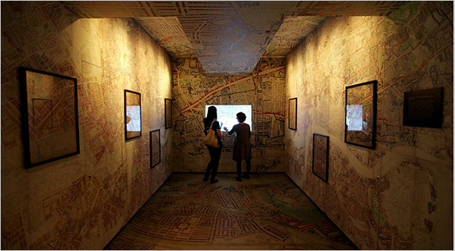
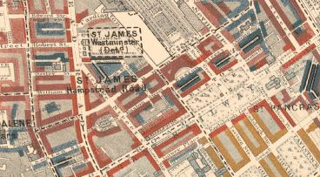
Understanding Urban Environments
Data
Analysis
Information
Description
BLACK: Lowest class. Vicious, semi-criminal.
DARK BLUE: Very poor, casual. Chronic want.
LIGHT BLUE: Poor. 18s. to 21s. a week for a moderate family
PURPLE: Mixed. Some comfortable others poor
PINK: Fairly comfortable. Good ordinary earnings.
RED: Middle class. Well-to-do.
YELLOW: Upper-middle and Upper classes. Wealthy.

Slide 4

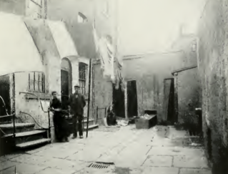
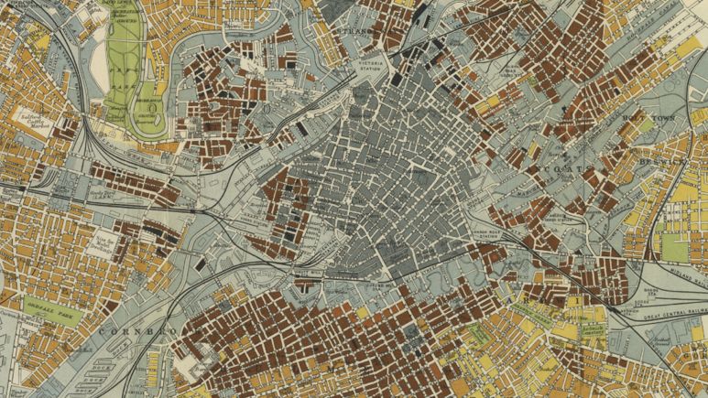
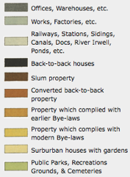
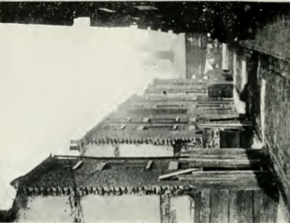
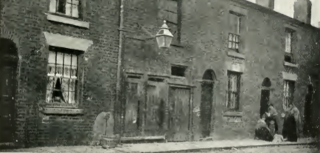
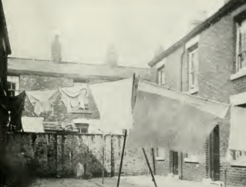
Understanding Urban Environments
Marr, T.R. (1904) Housing Conditions in Manchester and Salford. Manchester, Manchester University Press.

Slide 5

Some Emerging Problems for the Study of Cities

Slide 6

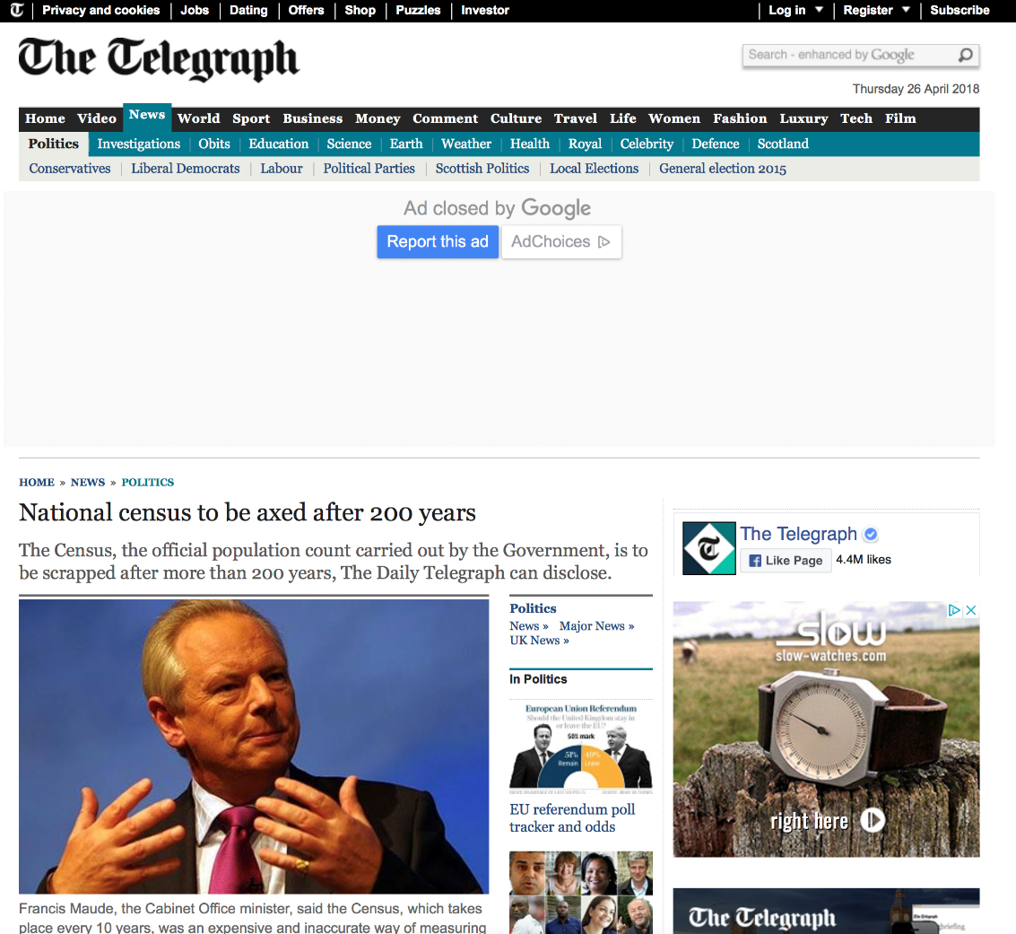

Conducting a Census is Expensive…
US 2010 census cost $13 billion, approximately $42 per capita

Slide 7


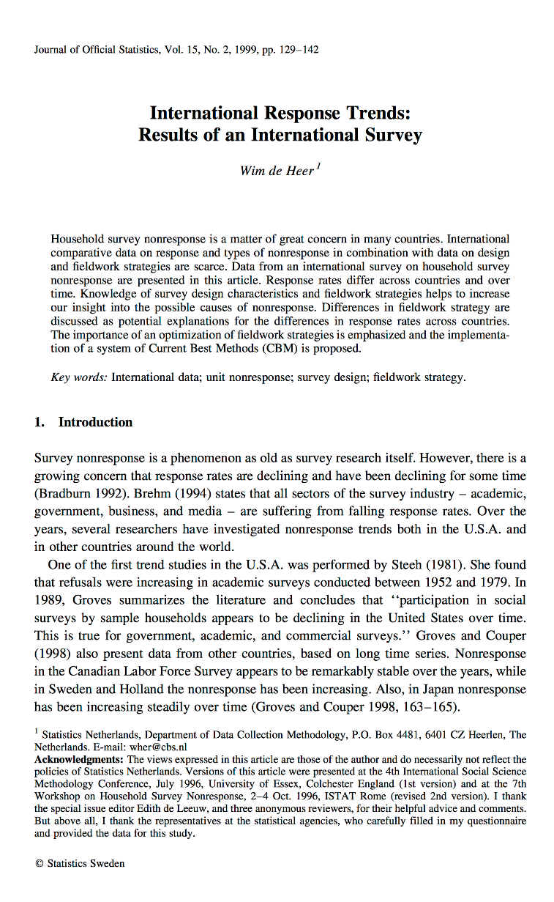


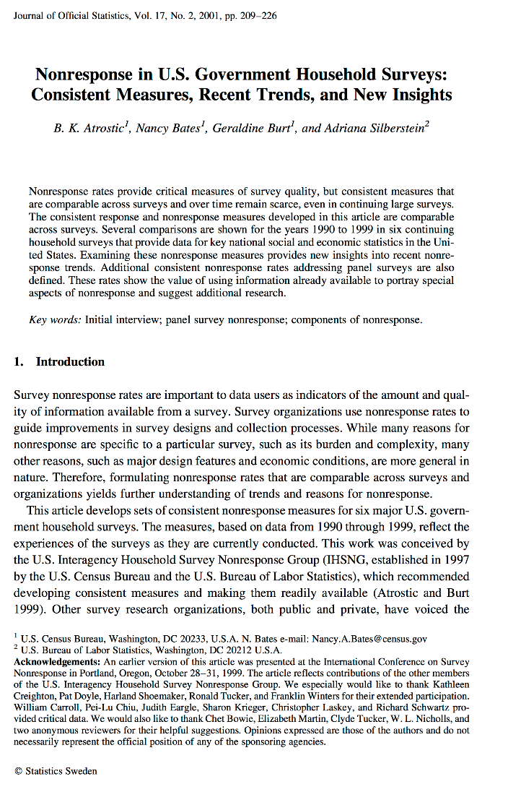
Survey Response Rates
“[Sample survey’s] glory years, we contend, are in the past”
Savage and Burrows, 2007: 890
“Refusals to participate are also increasing”
de Heer, 2004:5
Atrostic et al 2001; Baruch 1999; de Heer 1999; Plewis, 2007; Savage and Burrows, 2007;

Slide 8
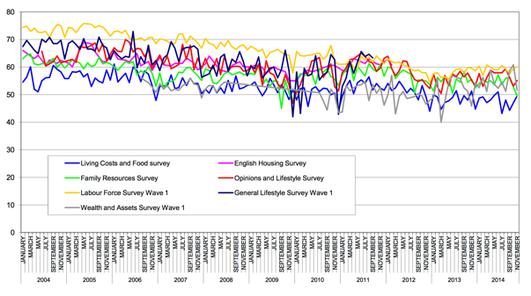
UK ONS Surveys 04-14
ONS; FOI Request: Survey Response Rates (Feb-2015)
Notes:
Source - http://webarchive.nationalarchives.gov.uk/20160111044551/http://www.ons.gov.uk/ons/about-ons/business-transparency/freedom-of-information/what-can-i-request/previous-foi-requests/people-and-places/survey-response-rates/index.html

Slide 9

External Review…
“difficult to trace specific evidence of the 'instrumental' or 'direct' policy impacts from these investments”
“Cohorts established long ago are inevitably no longer fully representative of their age groups in the current UK population”
Understand Society has had ~12k downloads in 10 years and cost ~£111m
https://esrc.ukri.org/files/news-events-and-publications/publications/executive-summary-longitudinal-strategic-review-2017/

Slide 10
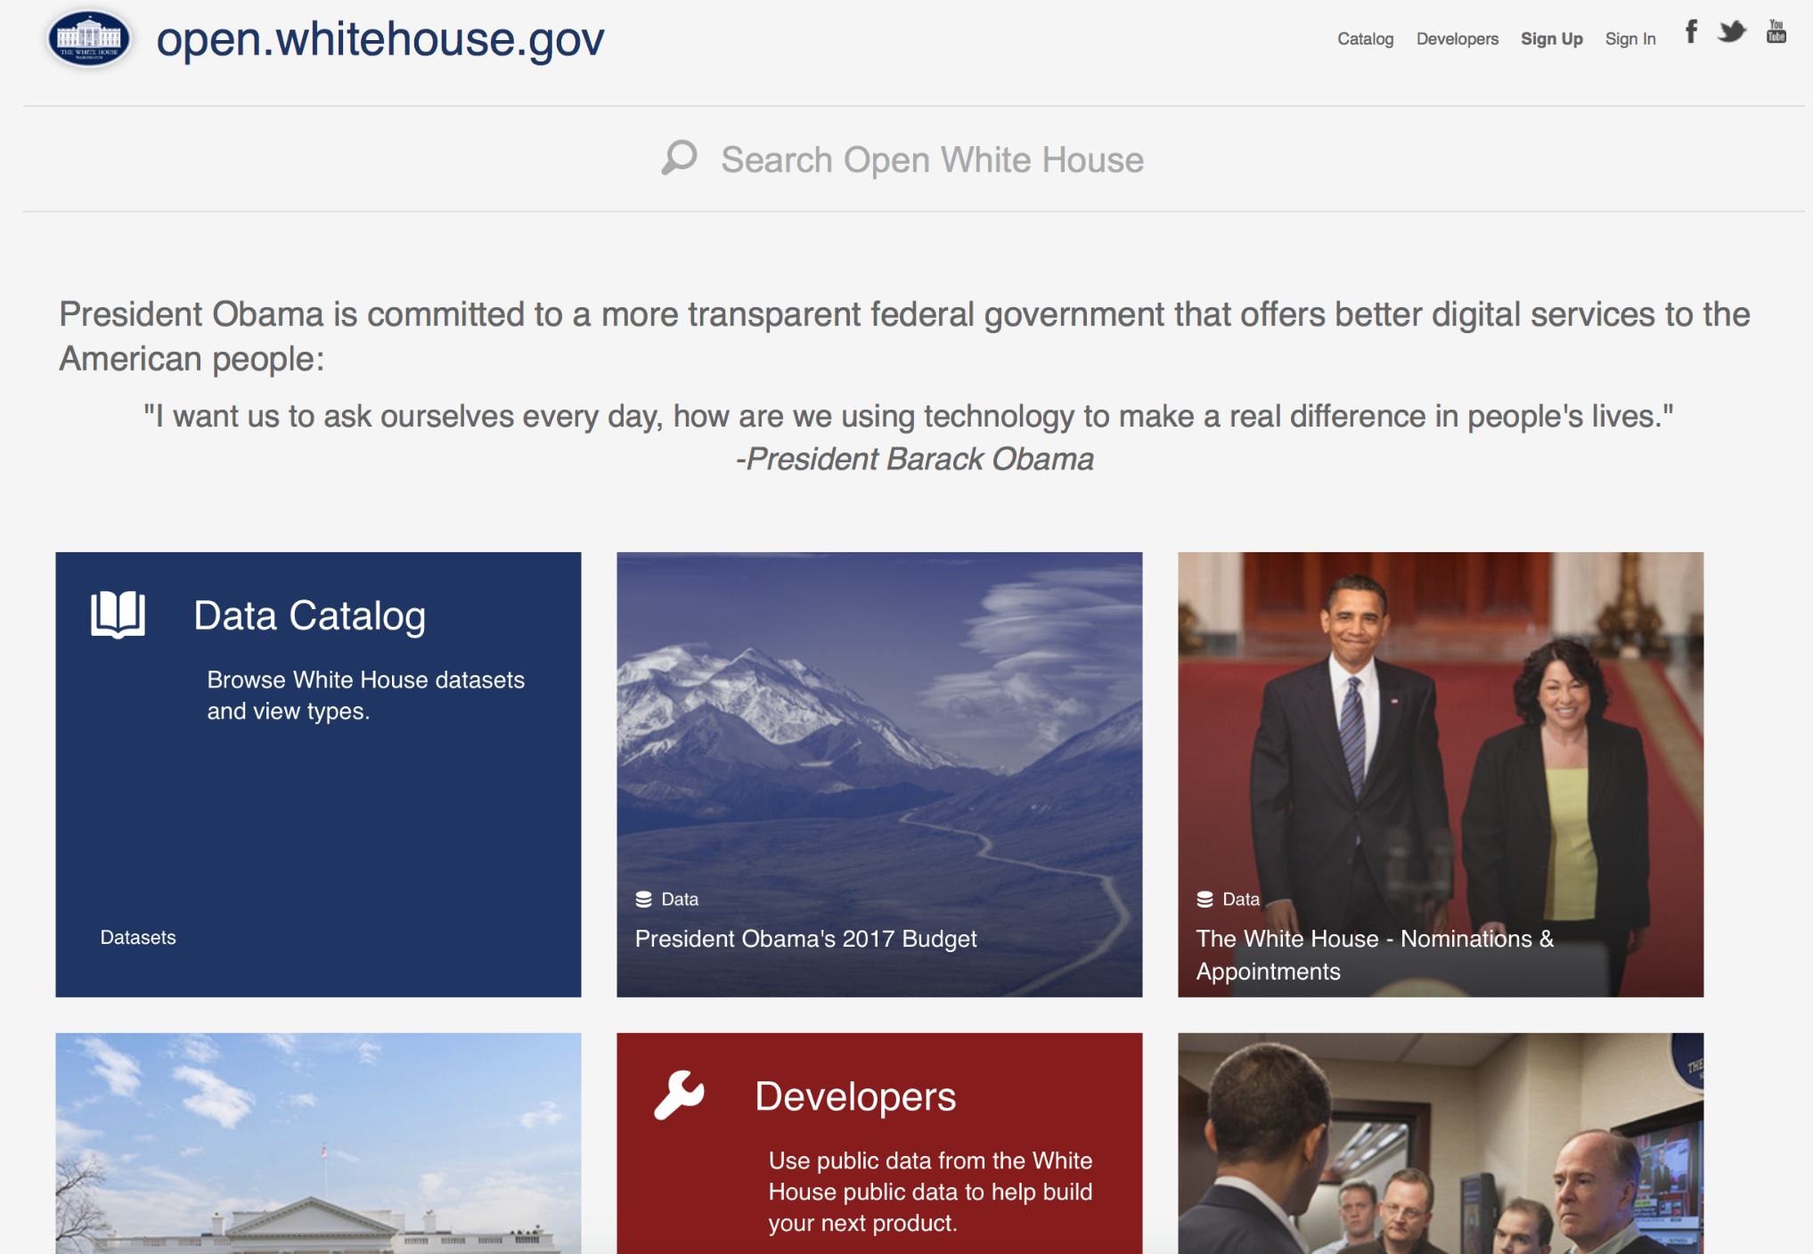
An Illusion of Permanence
open.whitehouse.gov

Slide 11
An Illusion of Permanence
open.whitehouse.gov

Slide 12
An Illusion of Permanence
No bulk data but OGL

Slide 13
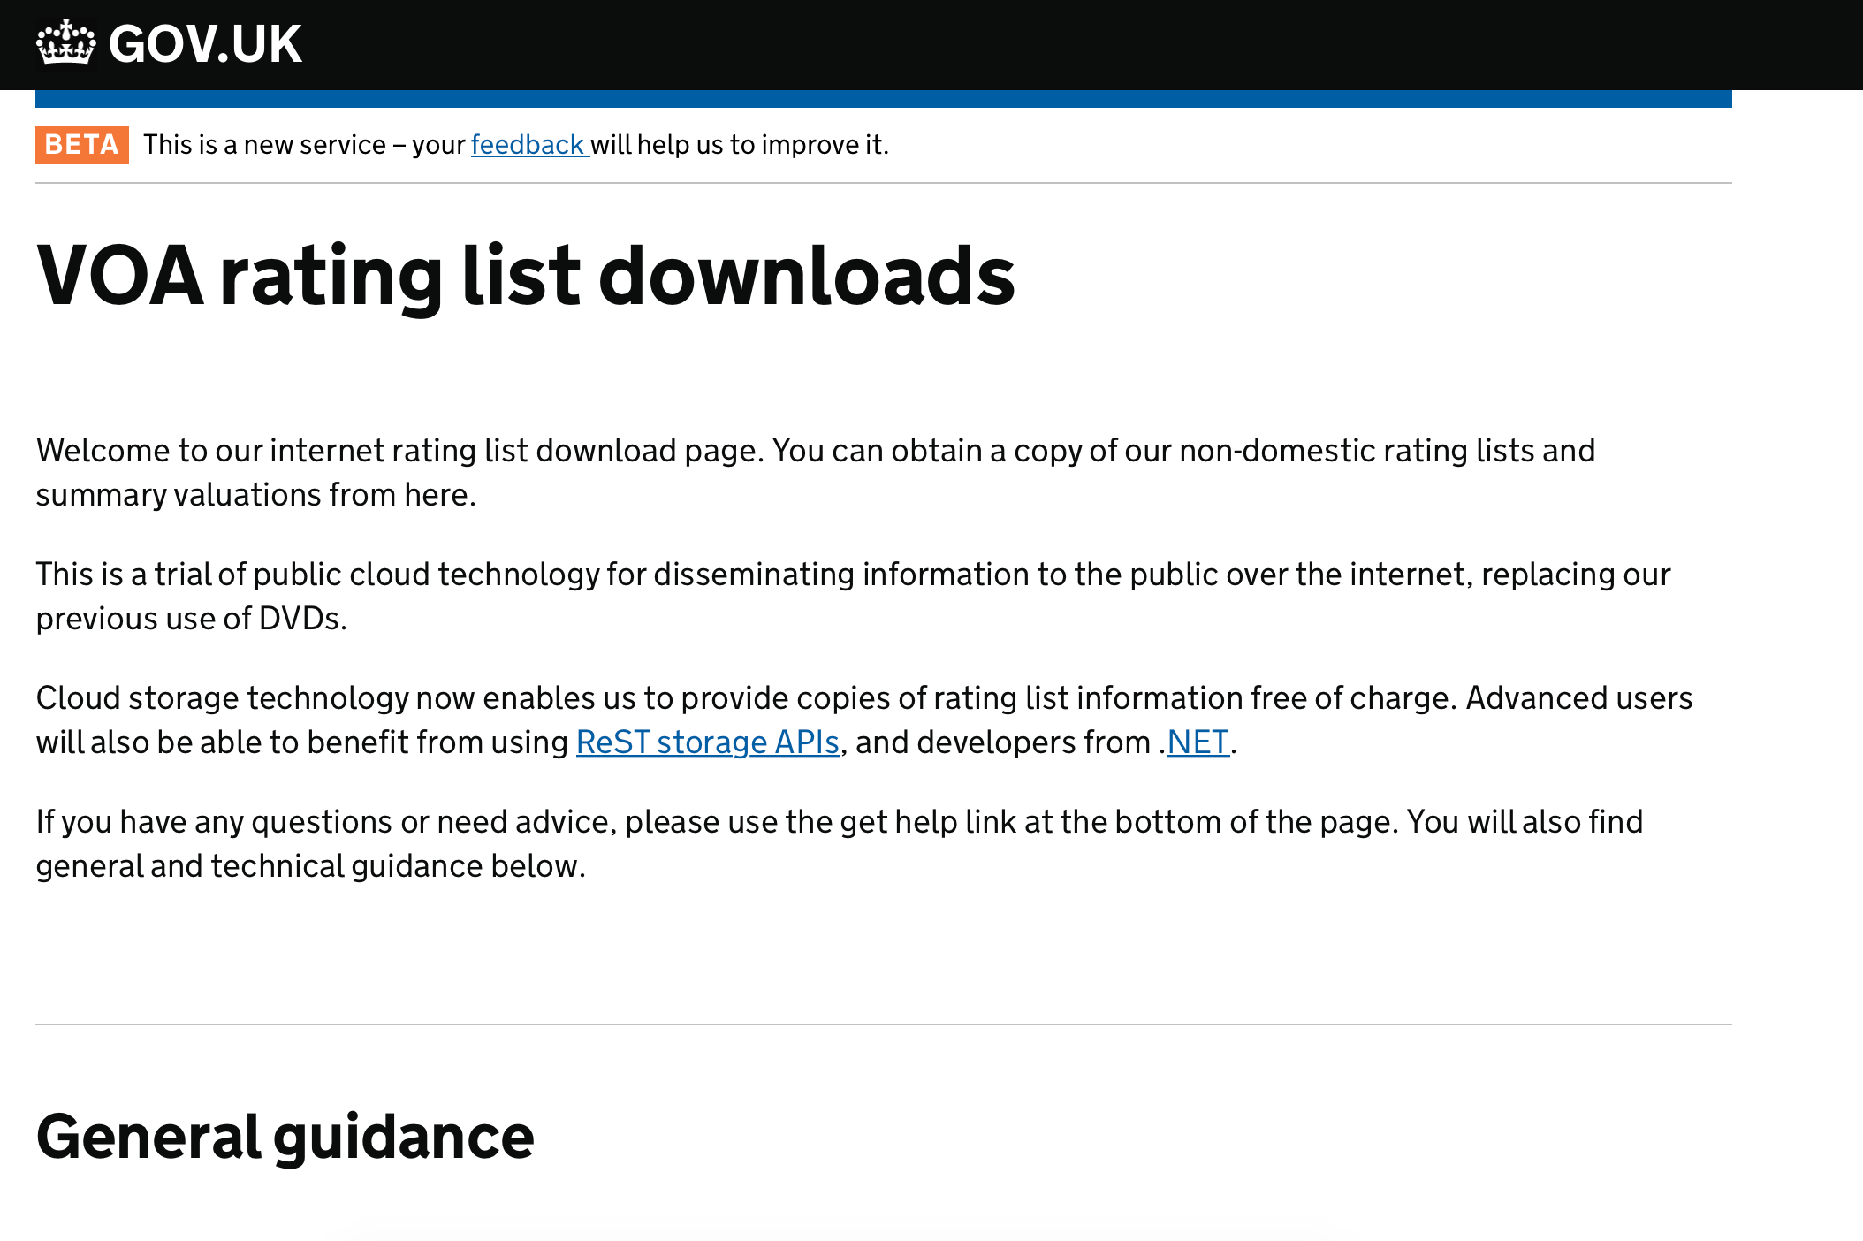
An Illusion of Permanence
Bulk & API

Slide 14
An Illusion of Permanence
“enable anyone to exercise their right to view rating assessments in the compiled rating lists”
> No aggregate statistics beyond those which are supplied by VOA
>No OGL

Slide 15
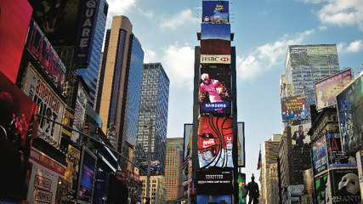
Urban Data
Transactional data
Consumers of products and services from the private and public sectors
VGI - social media
Sensor technology
Mobile / dynamic / linked humans
IOT - urban contexts
Times Square, NYC: Technology is integral to how cities can be managed and studied
Source: Photograph by Aurelien Guichard CC BY-SA (Flickr)

Slide 16
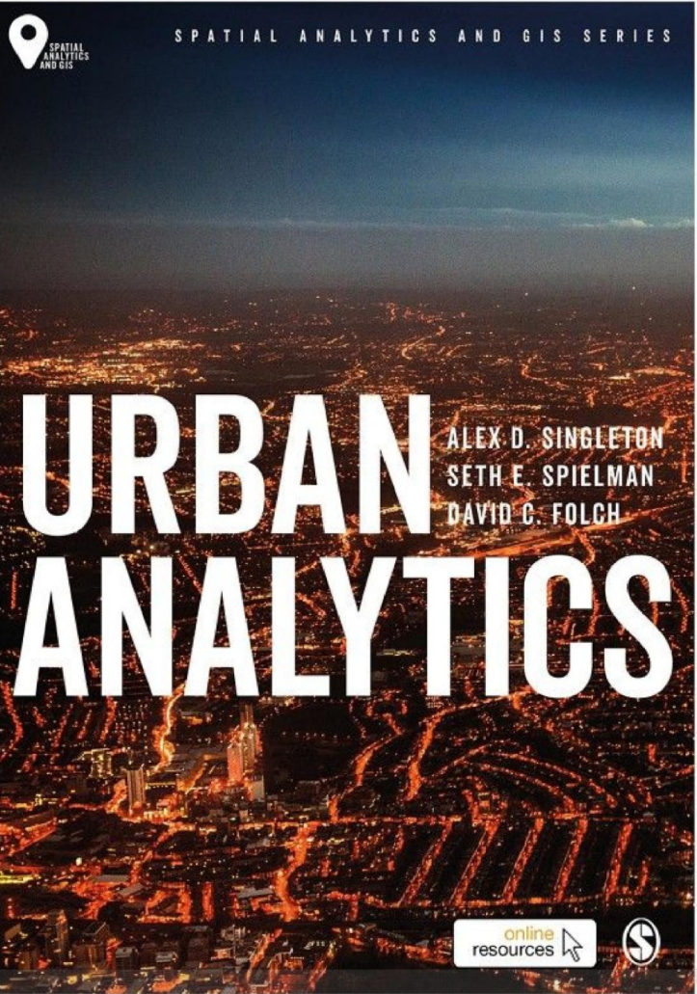
Urban Analytics
The multi-disciplinary area of research concerned with using new and emerging forms of data, alongside computational and statistical techniques, to study cities.
The use of data and statistics in the study of cities is nothing new
What is new is the quantity and variety of data available about cities.
Create a range of challenges…
https://uk.sagepub.com/en-gb/eur/urban-analytics/book249267

Slide 17
Understanding Urban Environments & GDS
Social / Political / Ethical / Legal Context
Data
GDS
Information

Slide 18

Data

Slide 19
Types of Data
Data processors (brokers)
Purchased, but licenses allow reuse
Data controllers (generators)
Free or Ingestion costs

Slide 20
Types of Data
Type | Costs | Benefits
Brokers | Can be expensive Data lineage difficult to audit | Simple to acquire
Owners | Requires trust Investment of time | Most valuable to social science research Better audit culture on operational data Often “Free”

Slide 21




Data Philanthropy
Private sector organizations sharing their data for the public good

Slide 22
Data Philanthropy
Why?
Corporate responsibility
Brand building / reputation protection
Strategic – recruitment
Part of a business model (selling data)
New markets? Low cost R&D?

Slide 23
Models for Data Philanthropy
Business releasing anonymous data
Openly – e.g. Kaggle
NDA – with each research user
On site access (or via VPN) under NDA
Aggregated data or statistics through an API or website
Really this is information not data…

Slide 24
Models for Data Philanthropy
Constraints
Companies are very busy (time = money)
Data Science shortages (massive issue!!)
Risk adverse (data breach)
Reputation damage; jail!!!
Who do you ask to get access to data?
Is access egalitarian?

Slide 25
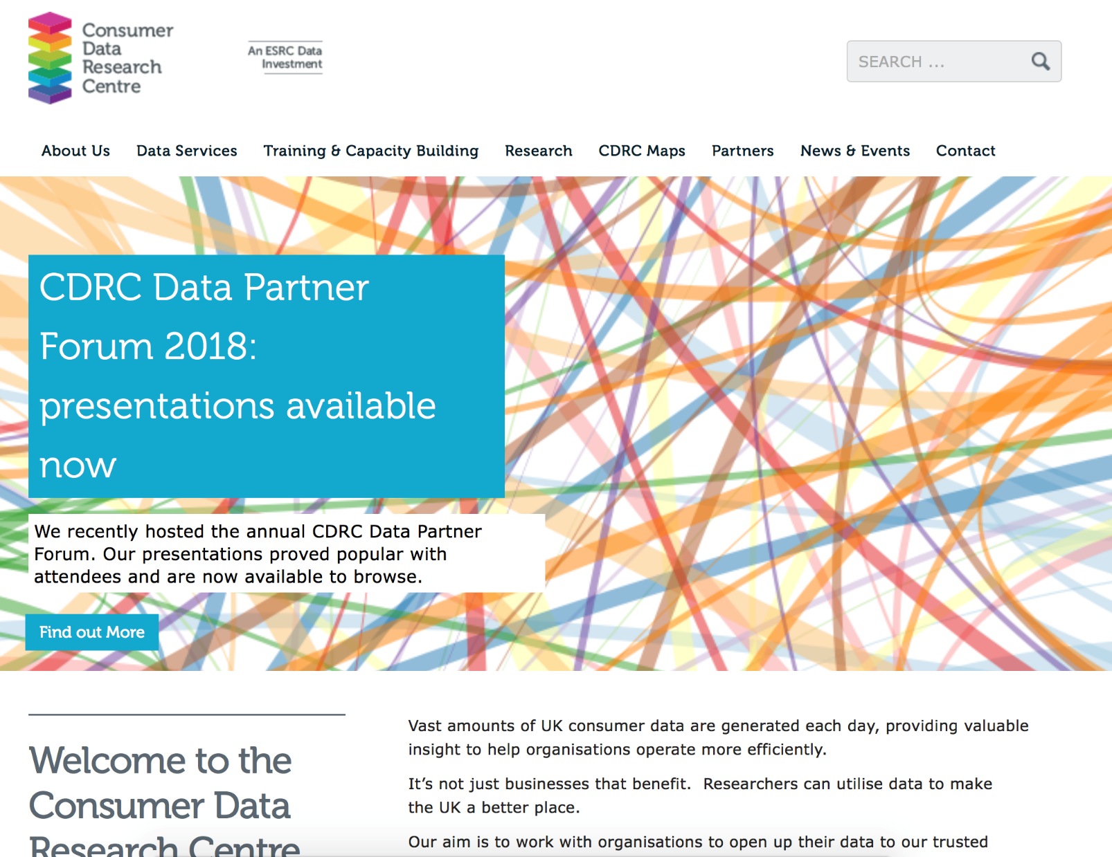
Consumer Data Research Centre
https://www.cdrc.ac.uk

Slide 26

GDS

Slide 27
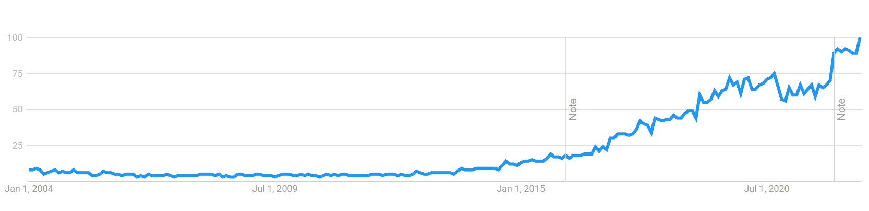
Data Science
Data Science (Google Trends)
Large increase in web generated data
Platforms to support their analysis

Slide 28








Slide 29

Geographic Data Science
Many problems in Data Science are spatial
Closer and careful coupling and assimilation of the connected fields of Geography with Data Science
Geography
Maths / Stats
Computer Science
https://doi.org/10.1111/gean.12194

Slide 30






Slide 31
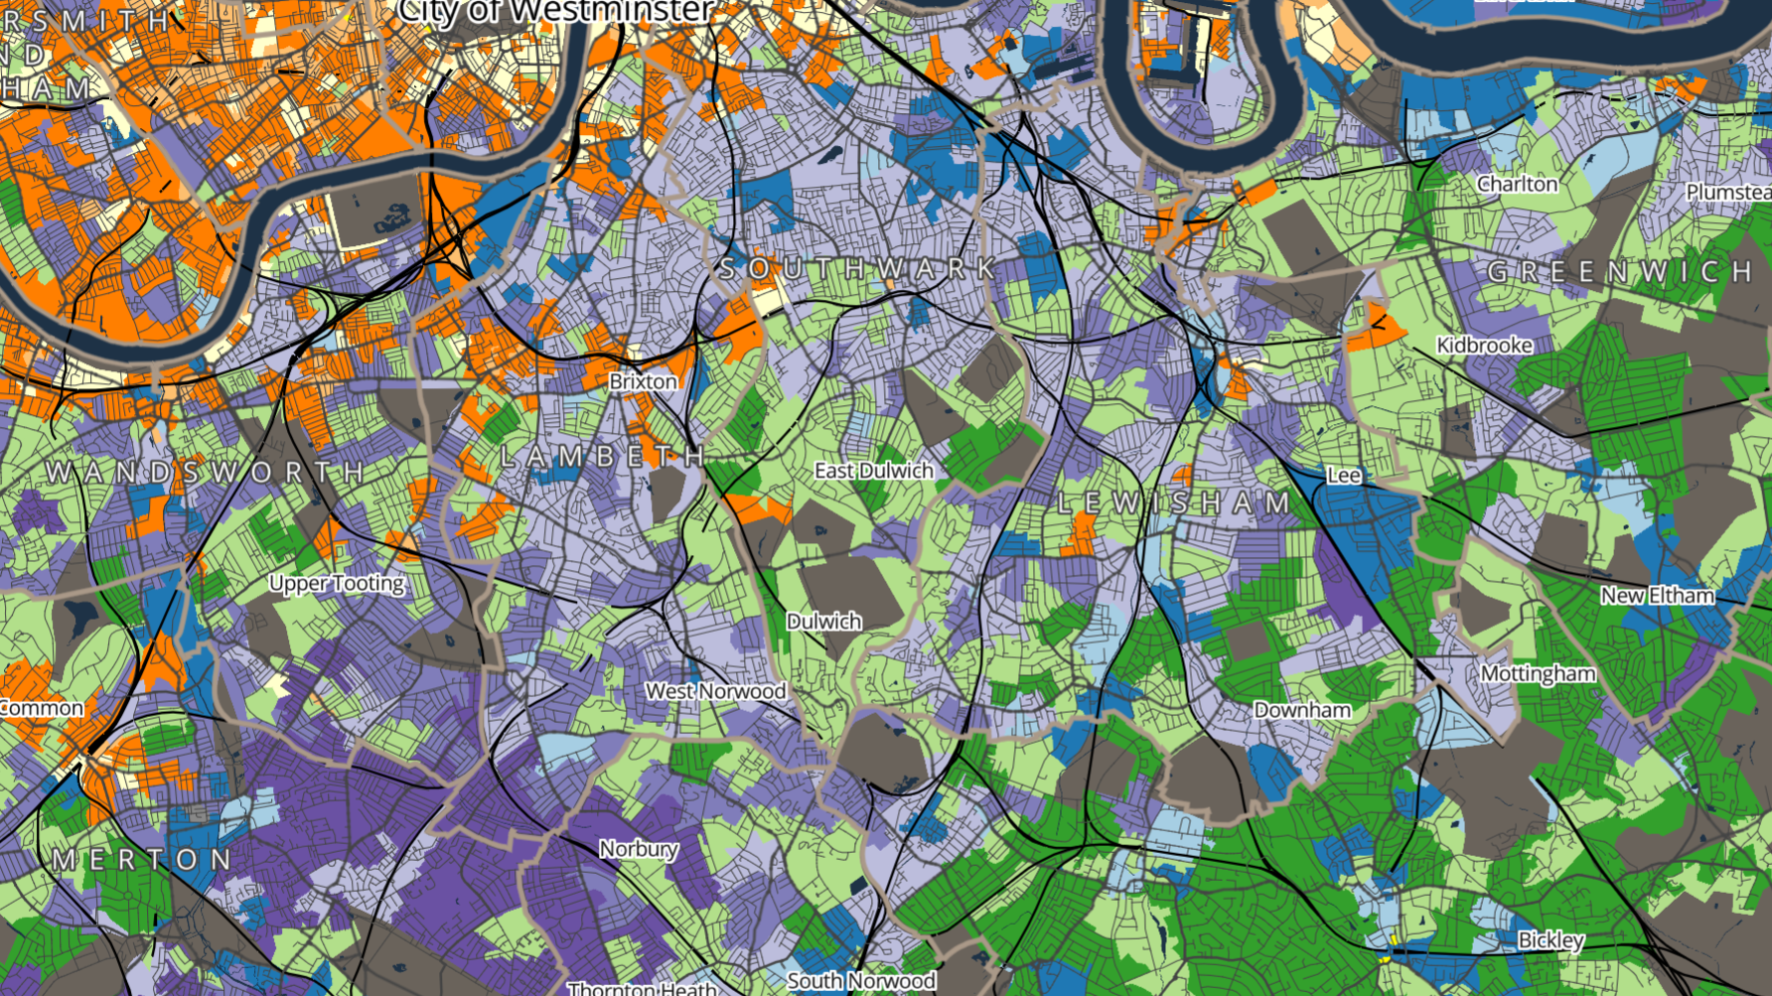
Insight

Slide 32
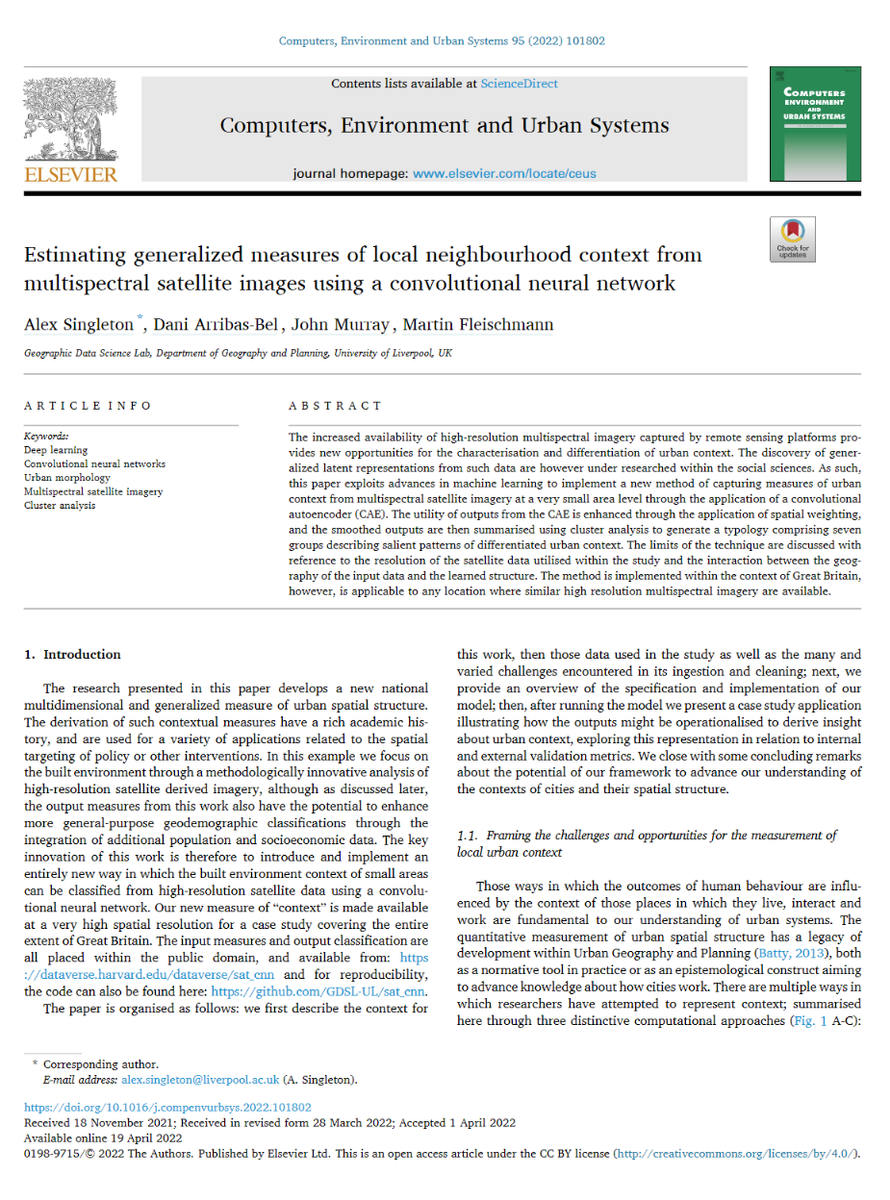
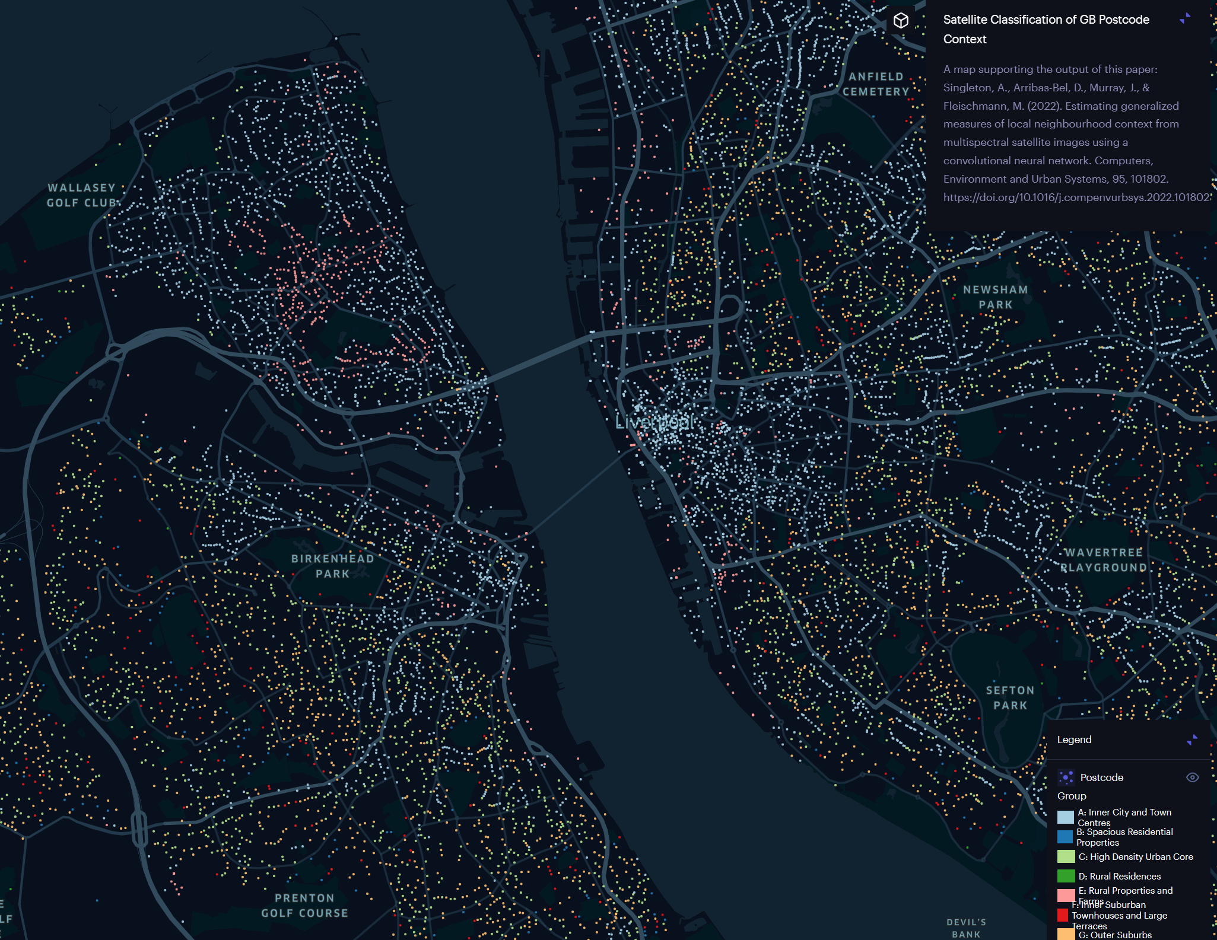
Neighbourhood Context from Space
https://doi.org/10.1016/j.compenvurbsys.2022.101802

Slide 33
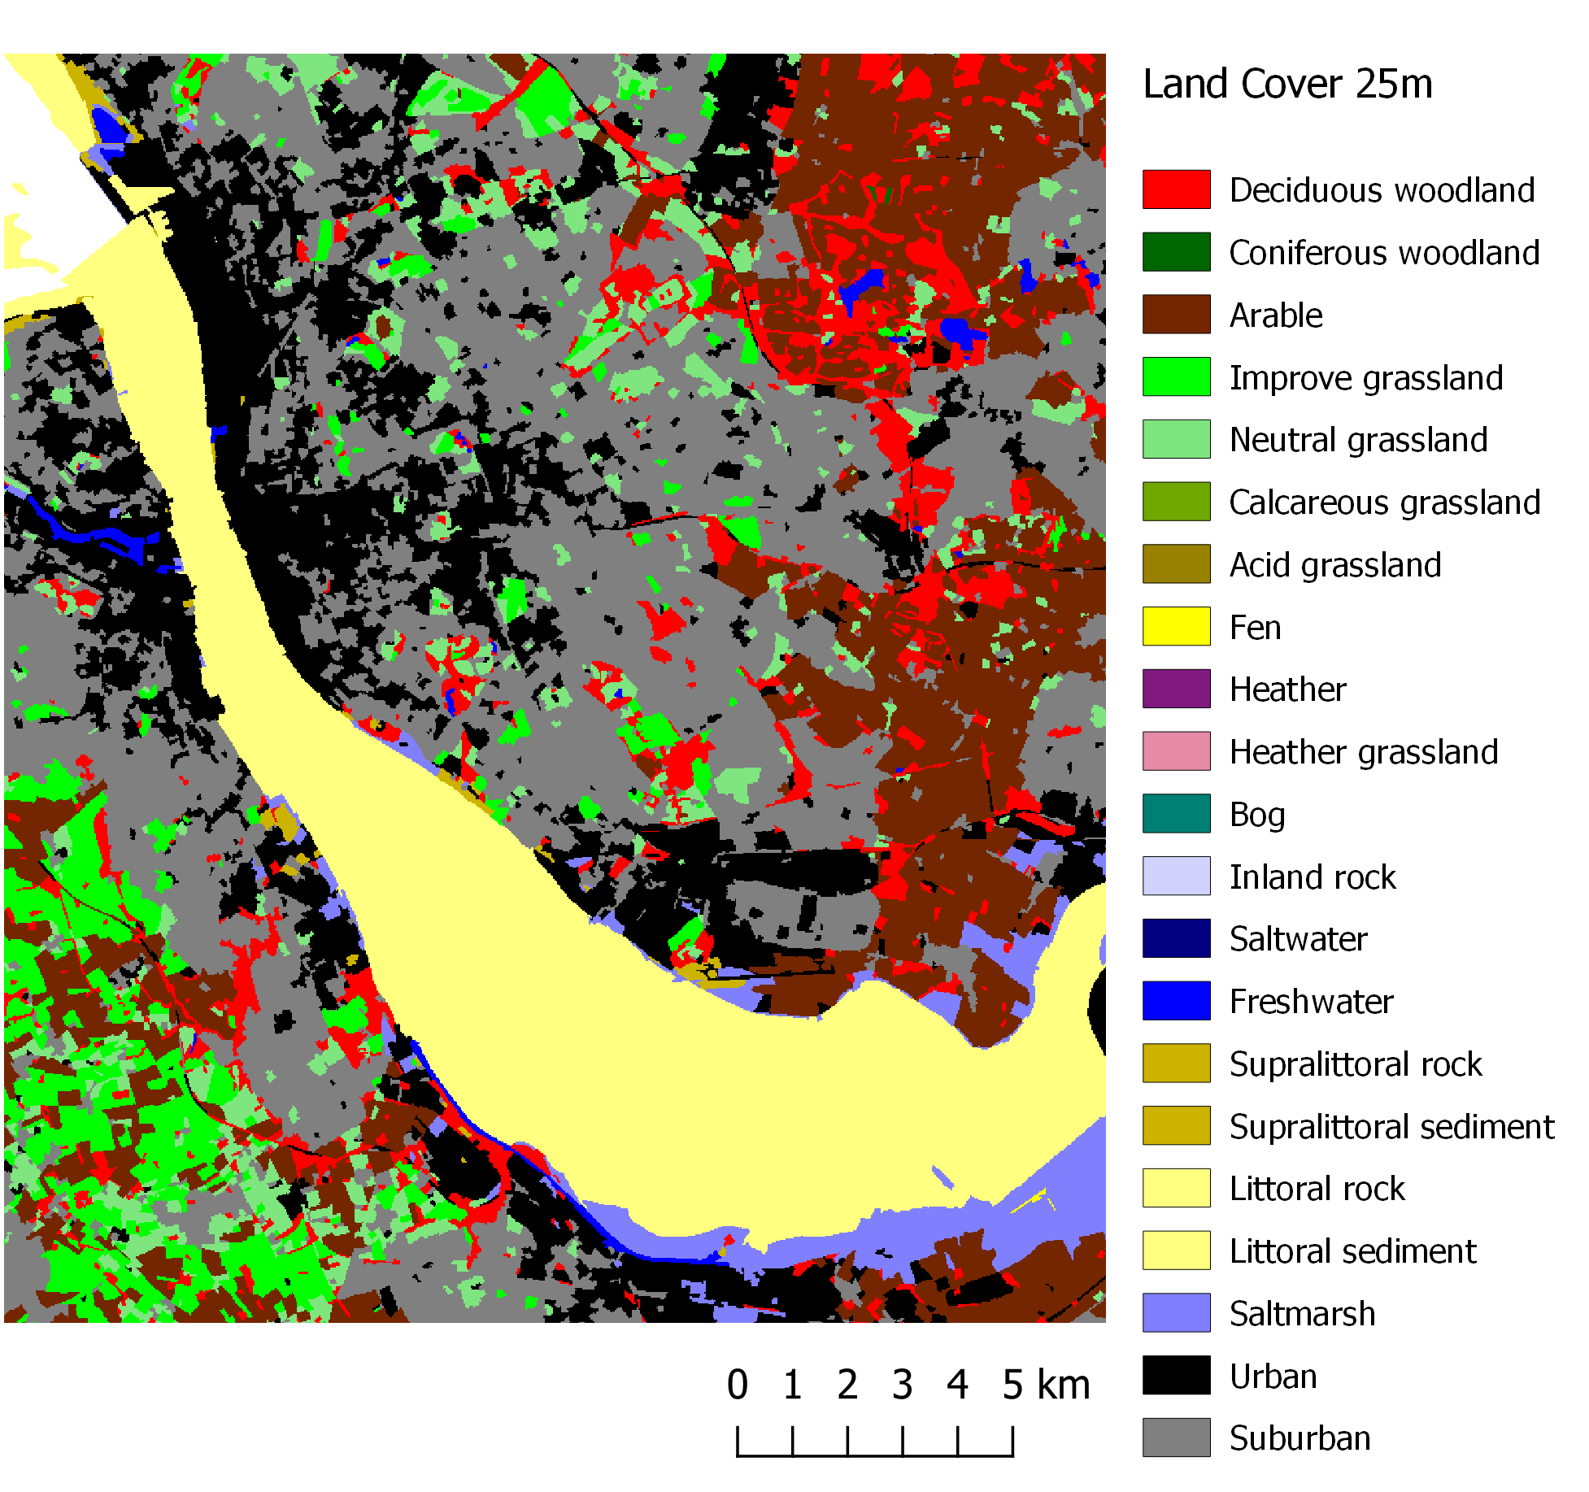
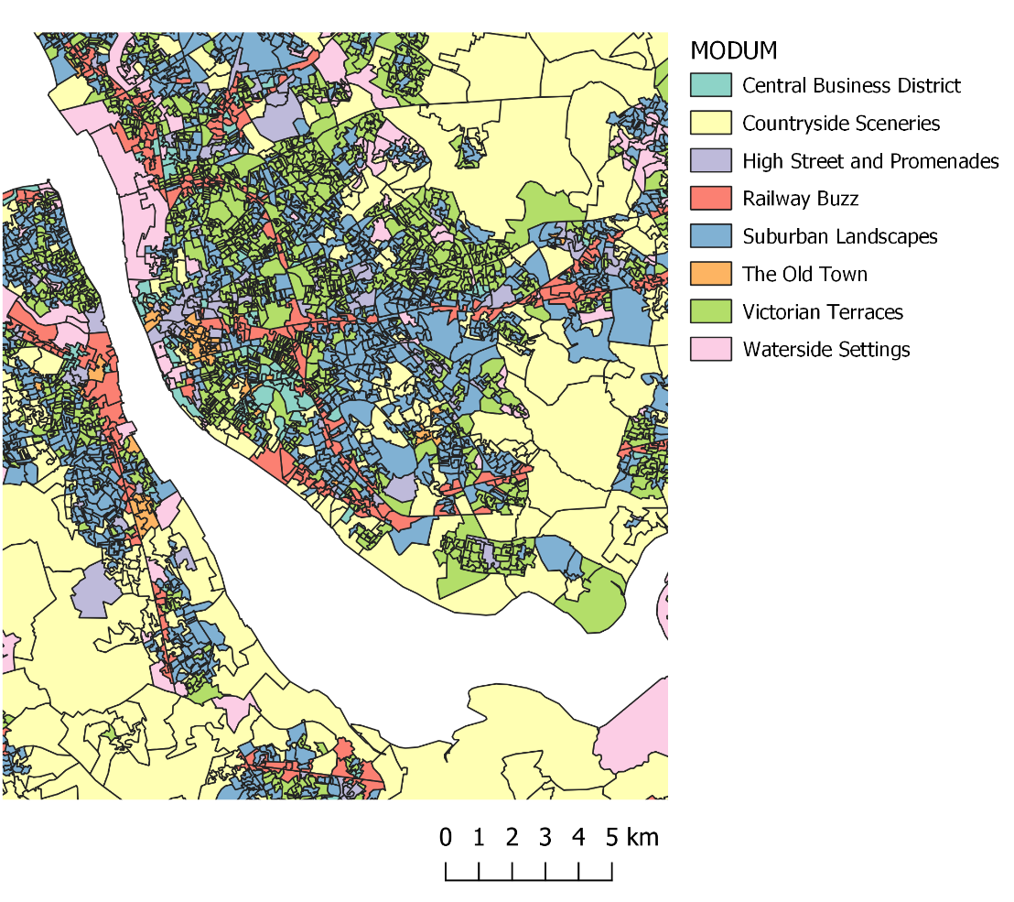
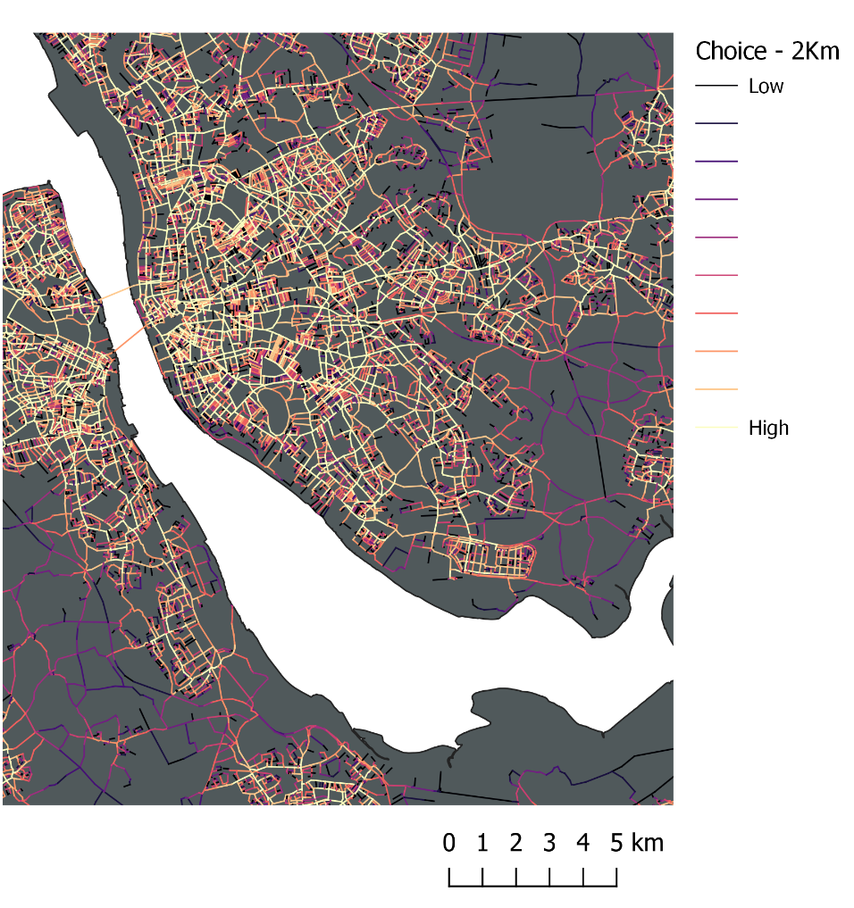
Models of Context…

Slide 34
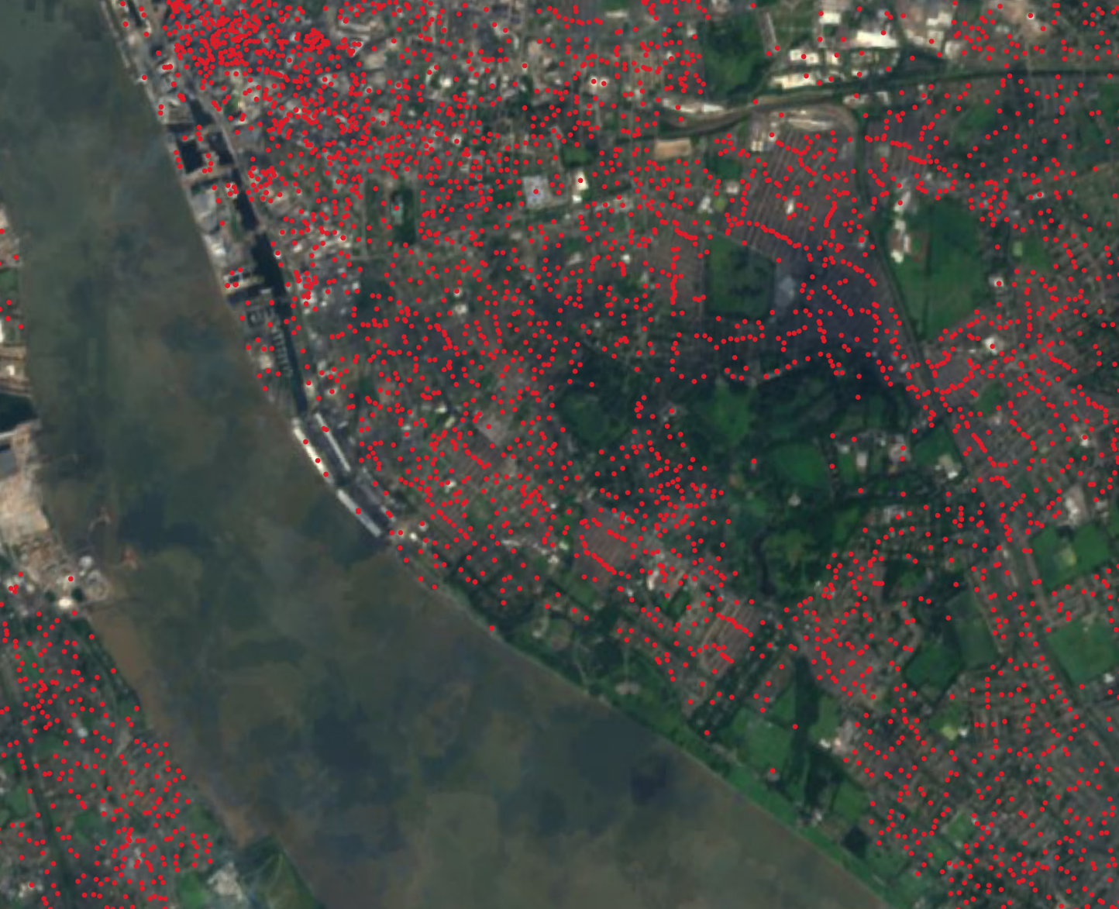
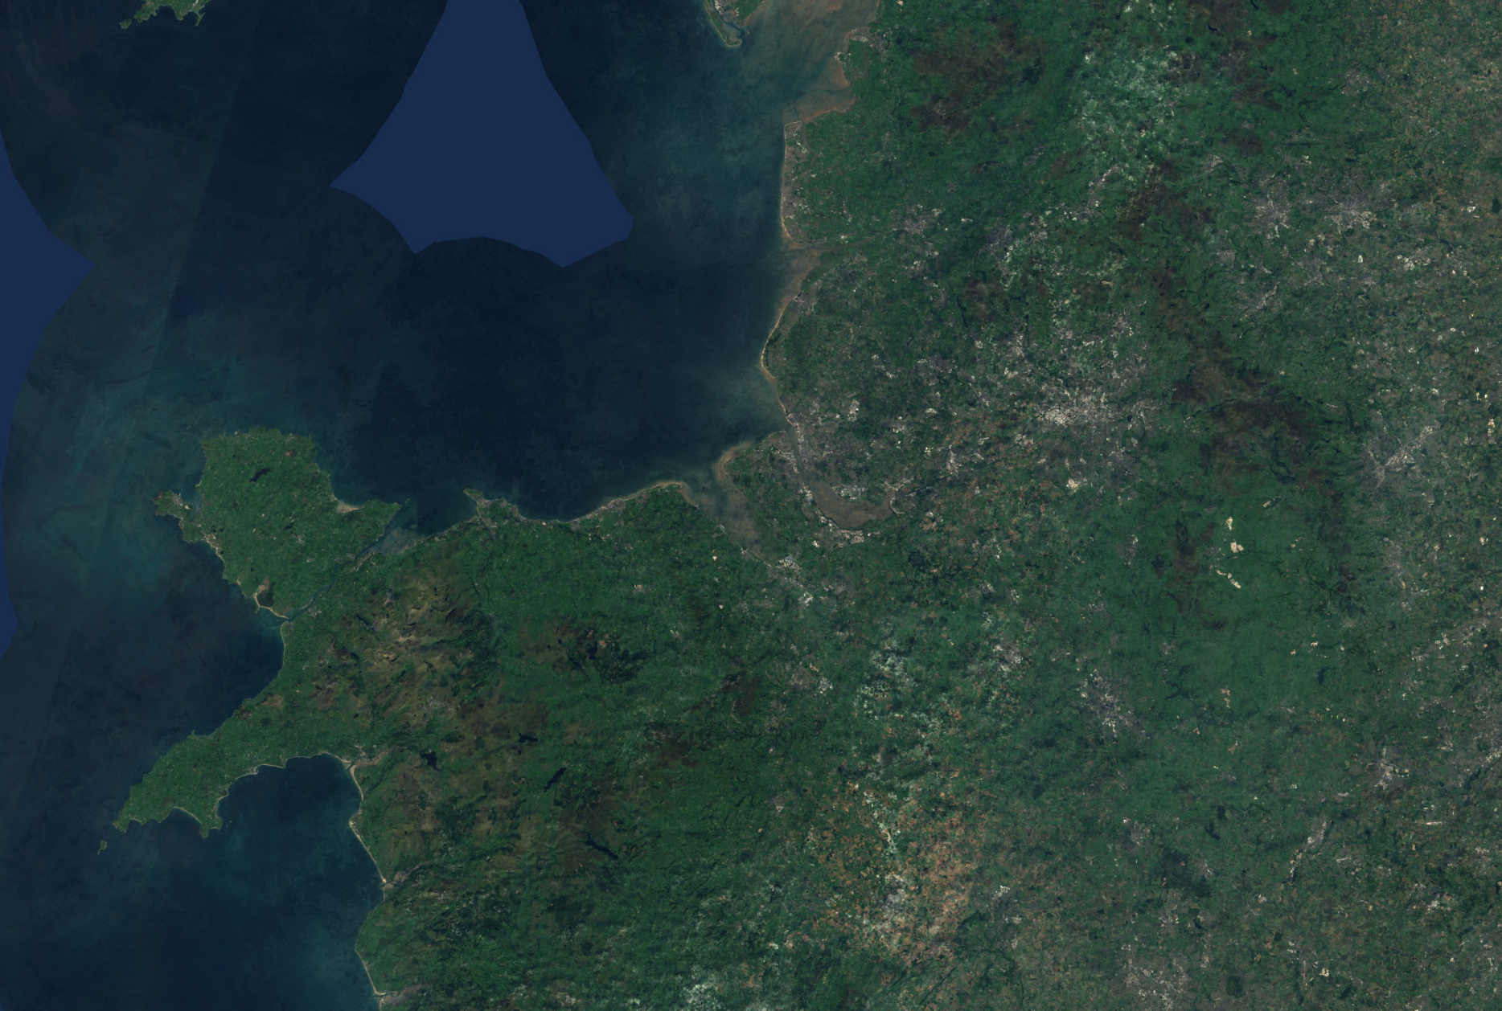
Localised Measure
Unit Postcodes (1.7m)
Sentinel 2 (R,G,B,NIR)

Slide 35
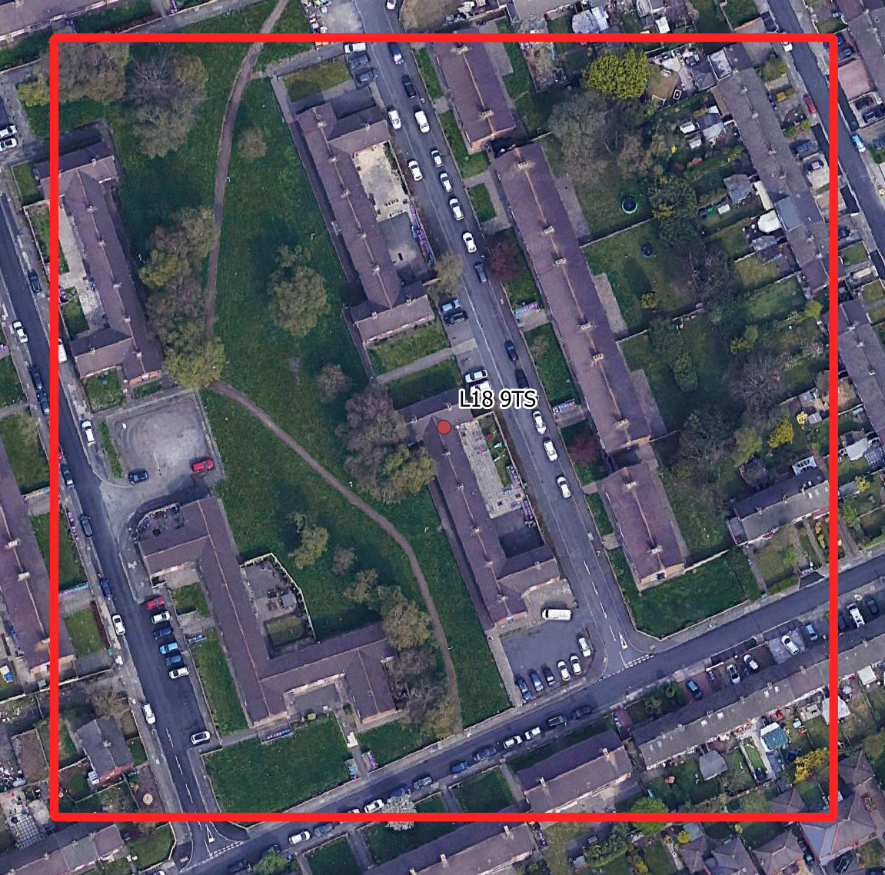
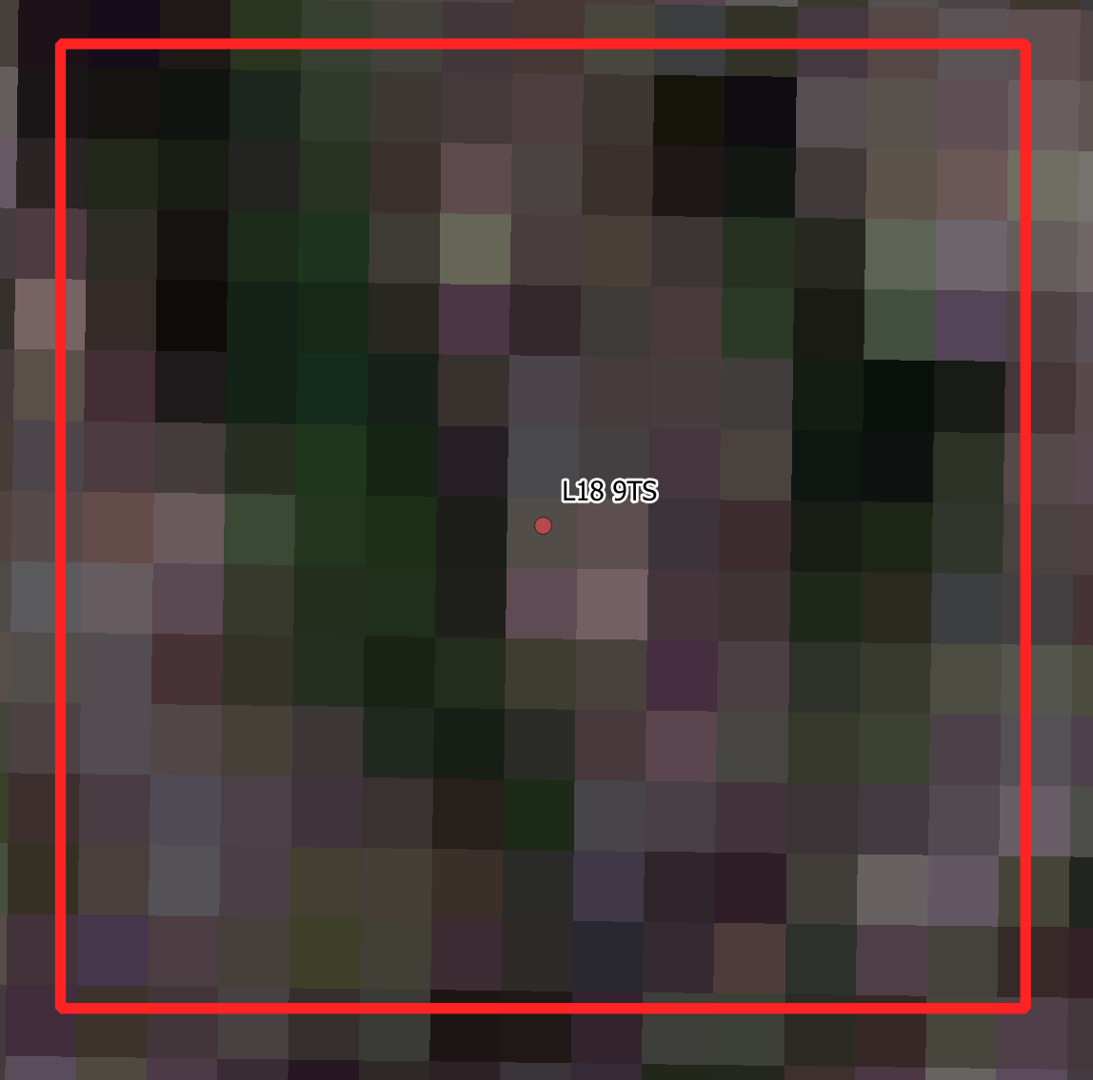
Buffer on Each Postcode
160m Square Buffer
10m Resolution Data (16 pixels)
Closest to the median unit postcode area (voroni polygons)
7th April to 21st September 2020
From swaths where the ESA metadata described 10% or less cloud cover
Each buffer checked

Slide 36
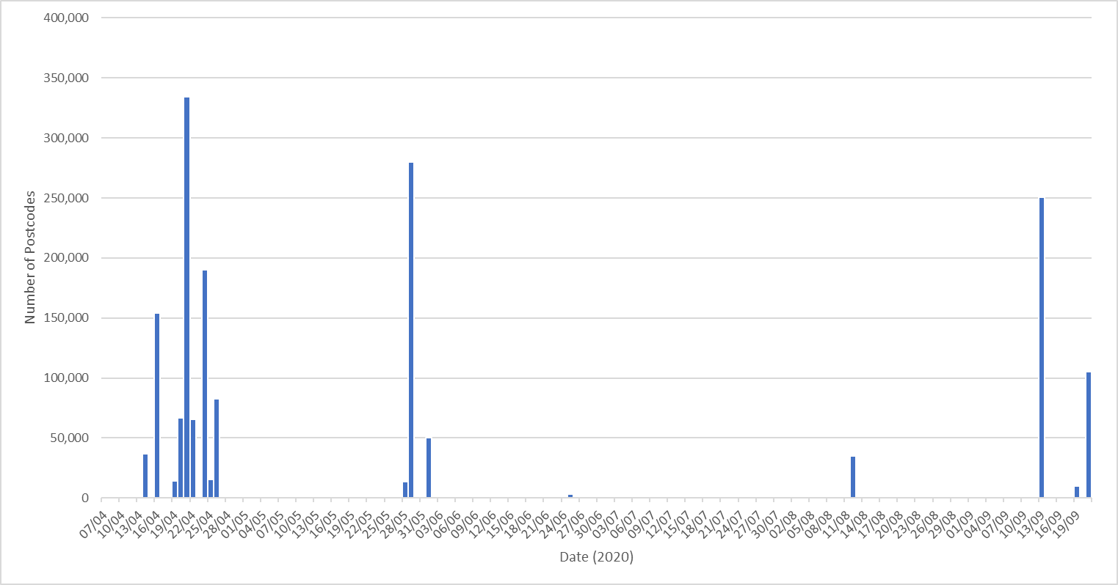
Tile Download

Slide 37
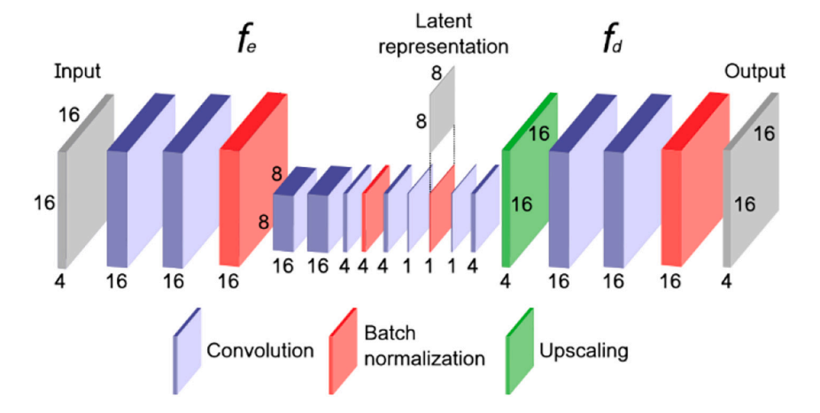
Autoencoder Architecture
GPU (NVIDIA RTX8000) environment
TensorFlow
A separate tensor (multidimensional array) for each postcode composed of four dimensions (Near Infra Red–NIR, Red, Green, Blue)
Convolutional Neural Network (CNN) to derive a set of discriminative features that retain the information contained in the satellite data but effectively compress its dimensionality.
Only keep the encoding phase (64 variables)
1024
64
(16X16X4)
(8X8X1)

Slide 38
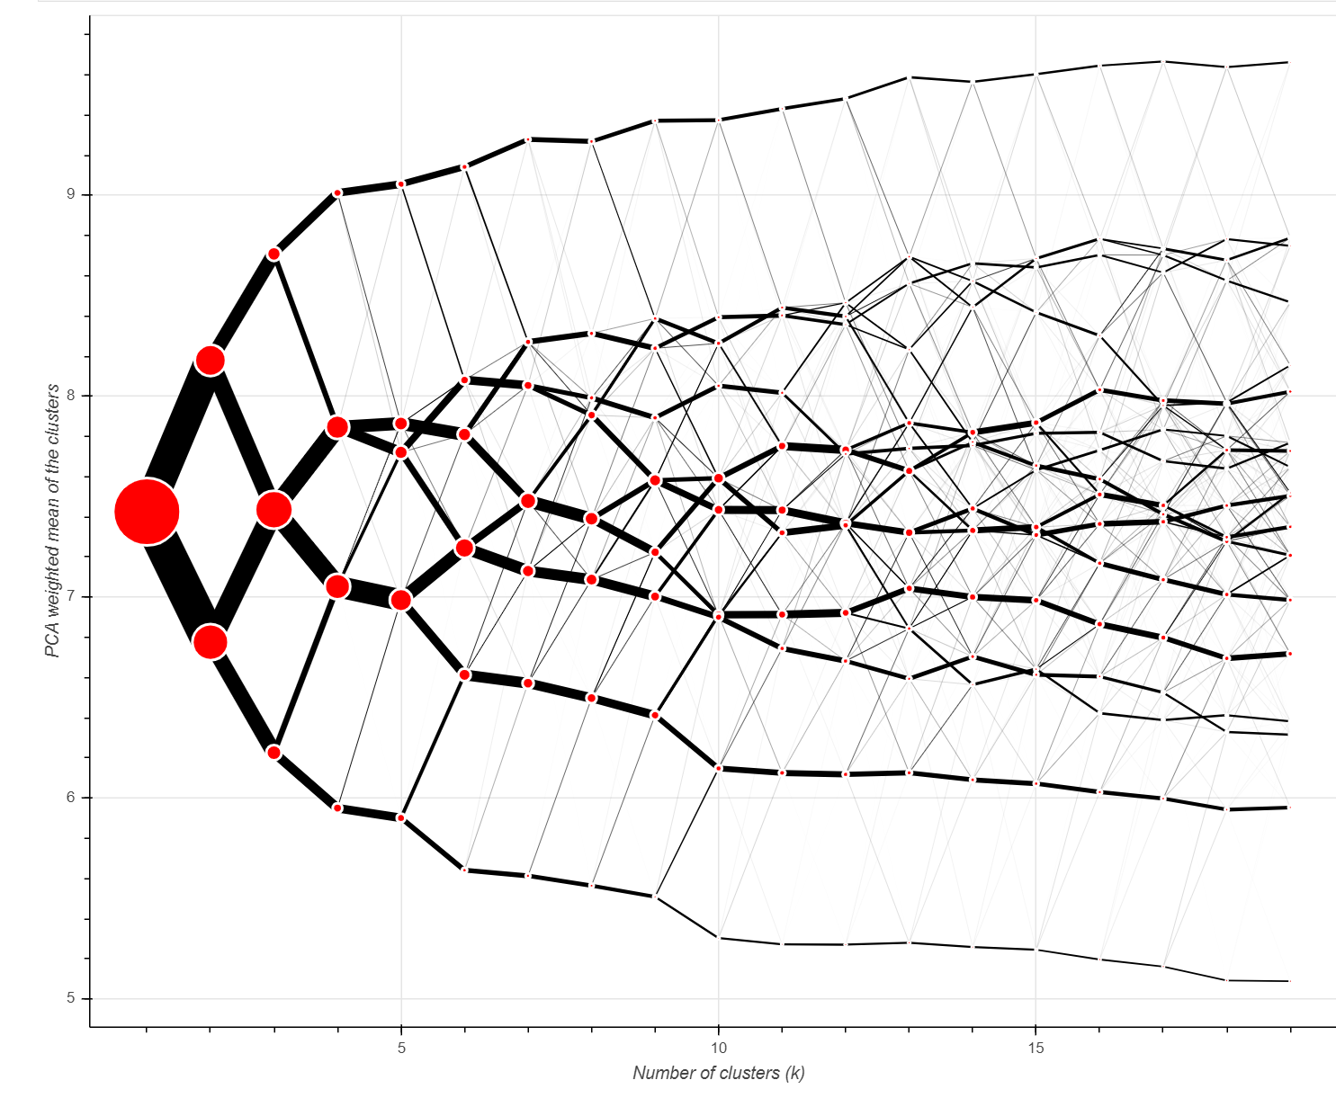
Choice of Clusters
K-Means – postcodes with similar values
Searched the feature space of its input data (1,710,715 × 64)
10,000 runs
K=7 Selected
https://pypi.org/project/clustergram/

Slide 39
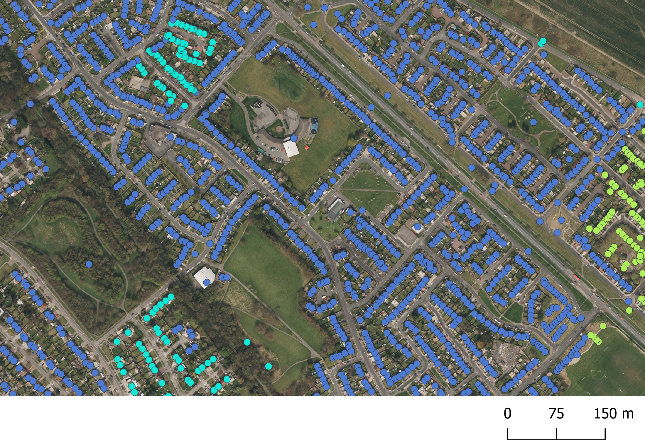
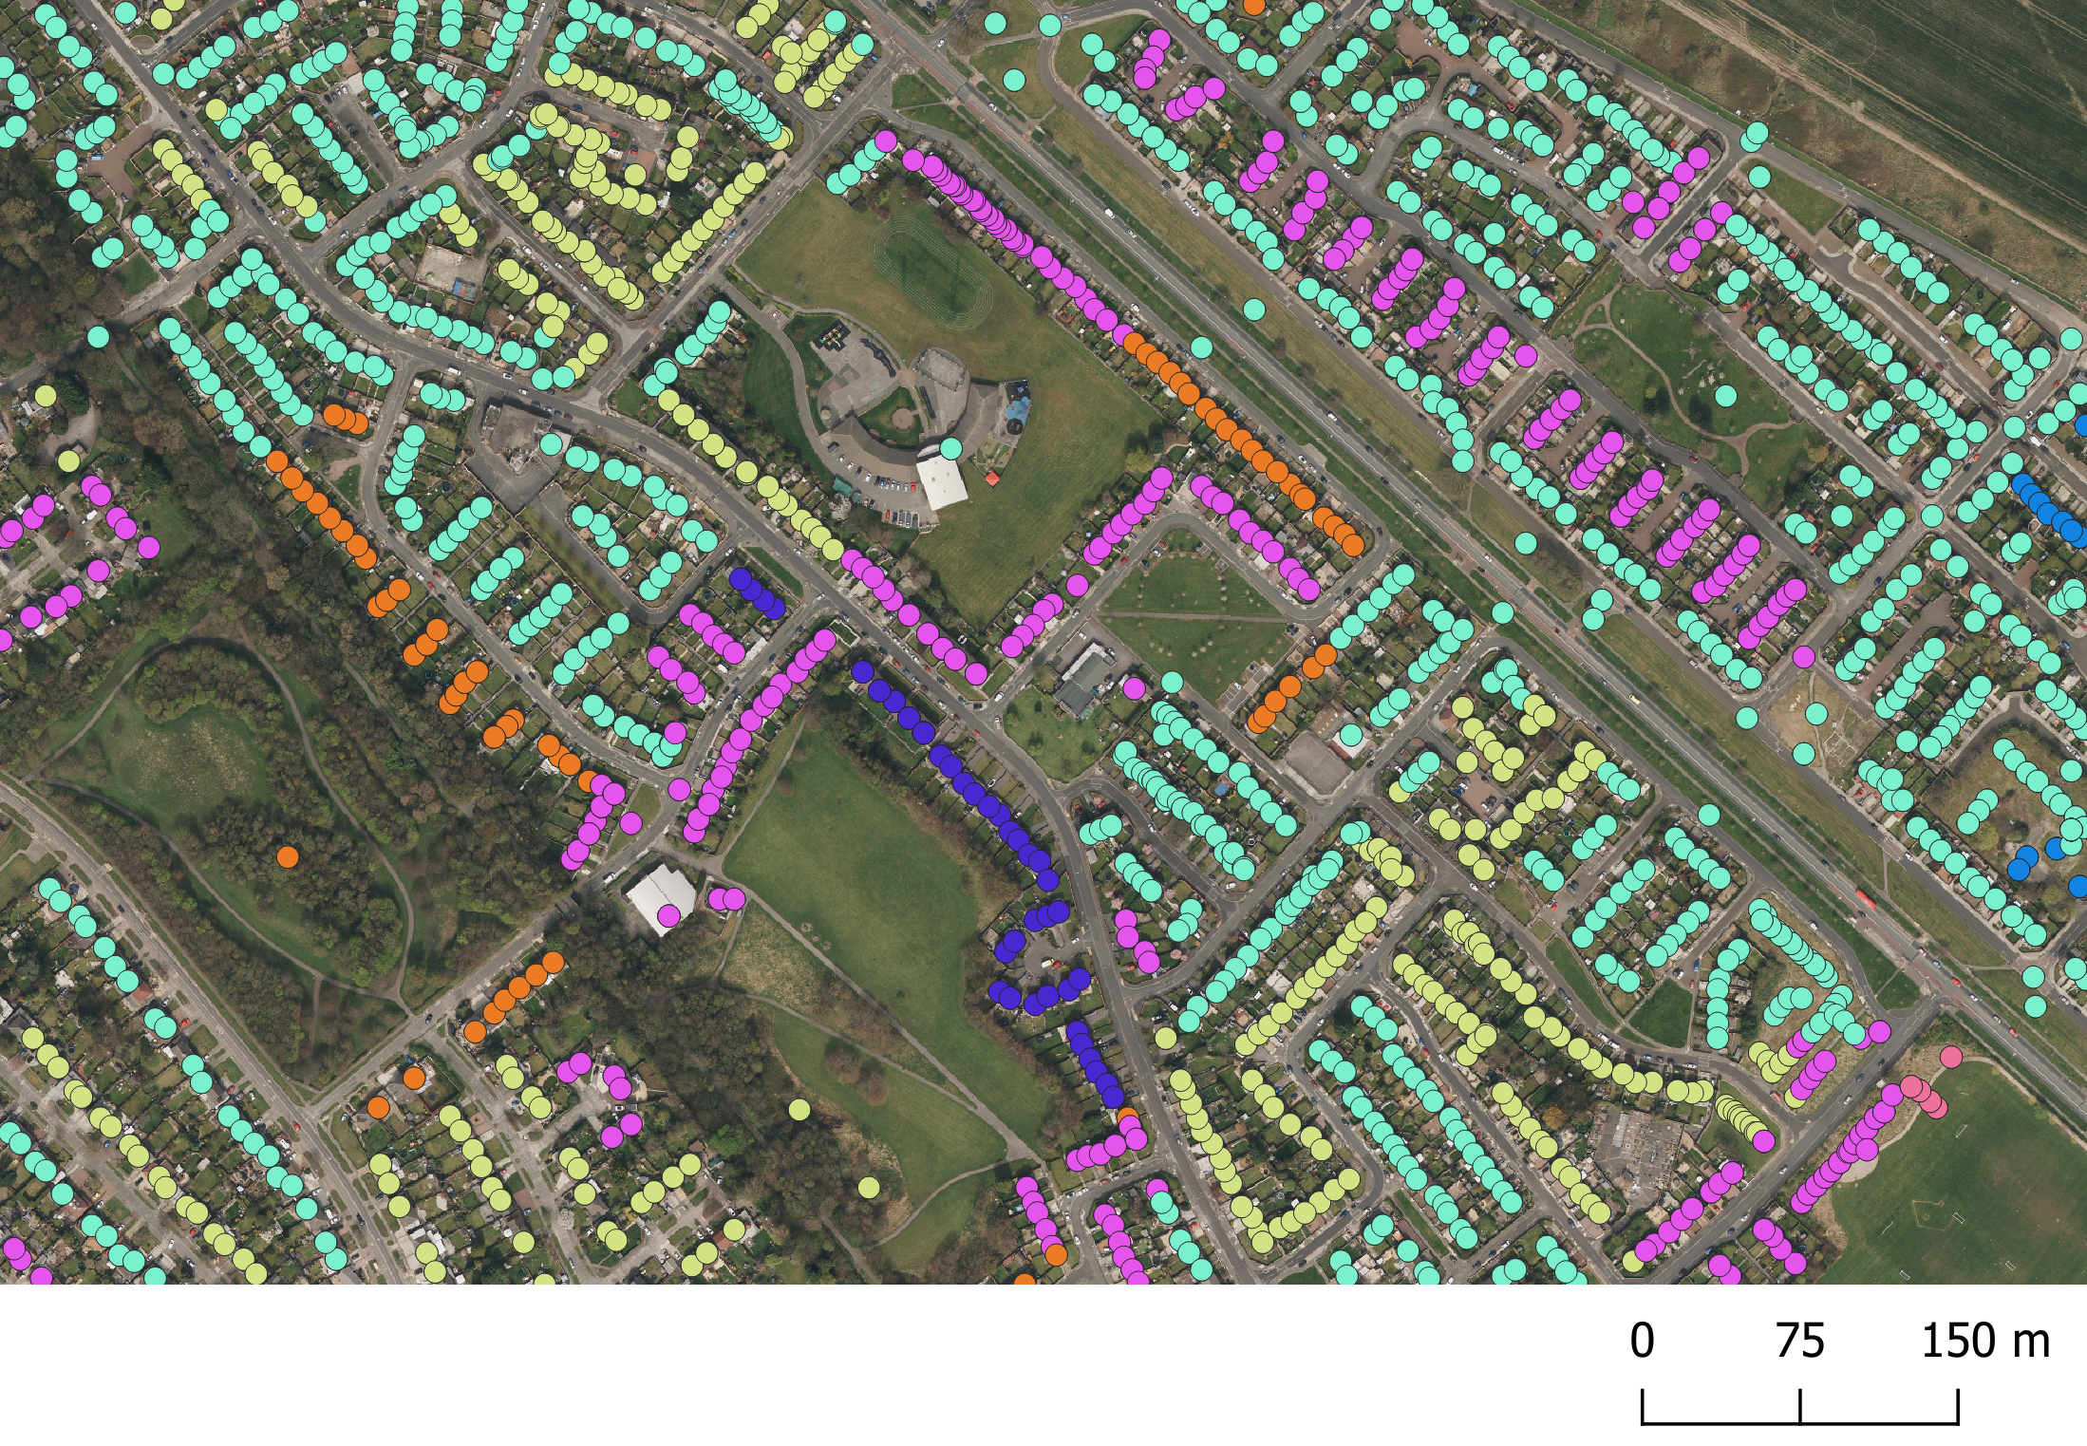
Outputs & Spatial Smoothing
Many of the clusters are not spatially contiguous; and although UPRN are shown here to better delineate street morphology; the input postcodes and their associated buffers are coarser.
Smoothed average for each of the 64 input measures was calculated for every postcode, comprising values from those postcodes found within each 160 m buffer.
Improves cluster fit

Slide 40
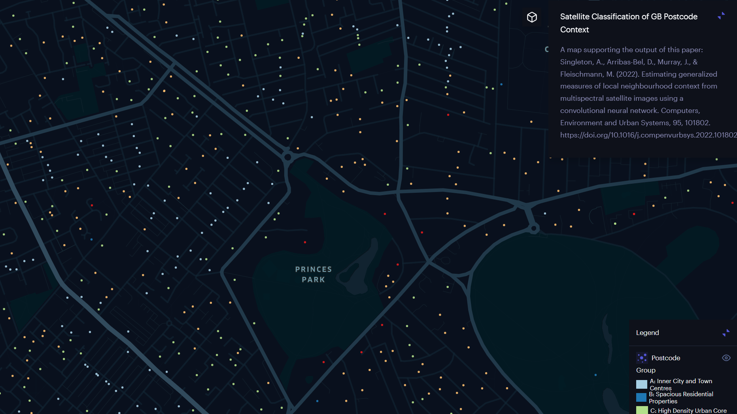
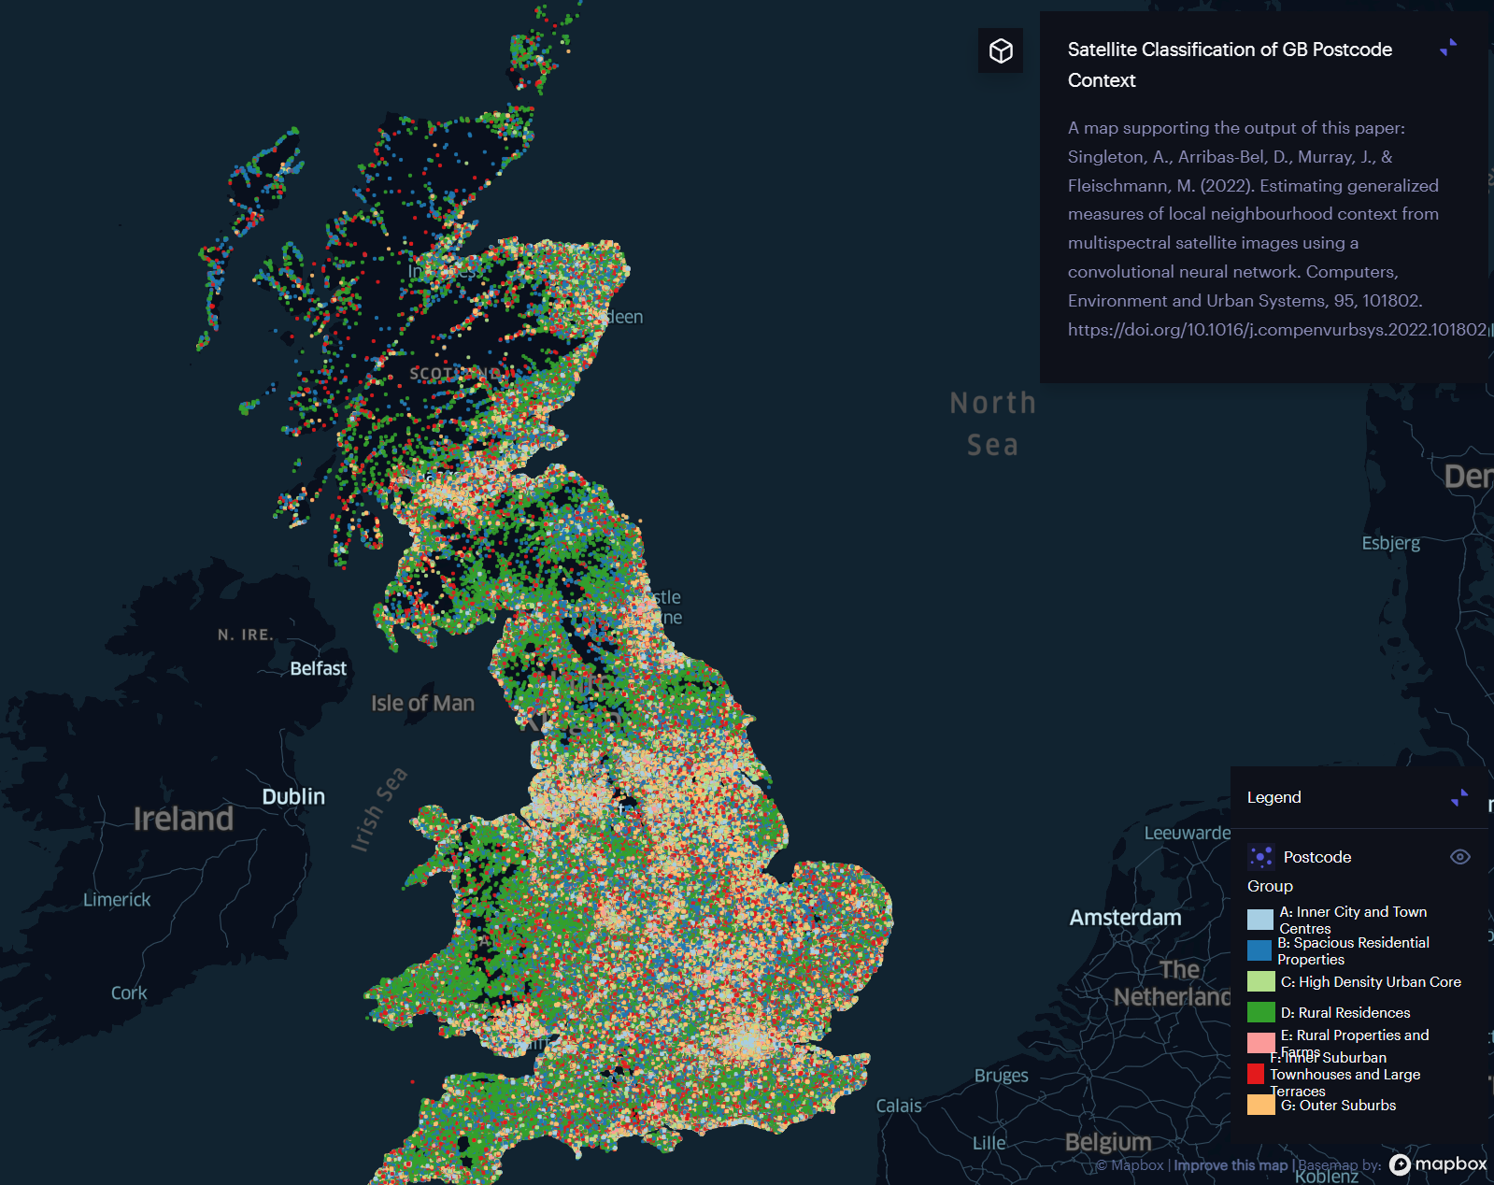
Final Classification
Group
A: Inner City and Town Centres
B: Spacious Residential Properties
C: High Density Urban Core
D: Rural Residences
E: Rural Properties and Farms
F: Inner Suburban Townhouses and Large Terraces
G: Outer Suburbs
https://studio.unfolded.ai/public/c40f0a5b-a1f8-48af-8b7d-7c258942cf0d

Slide 41
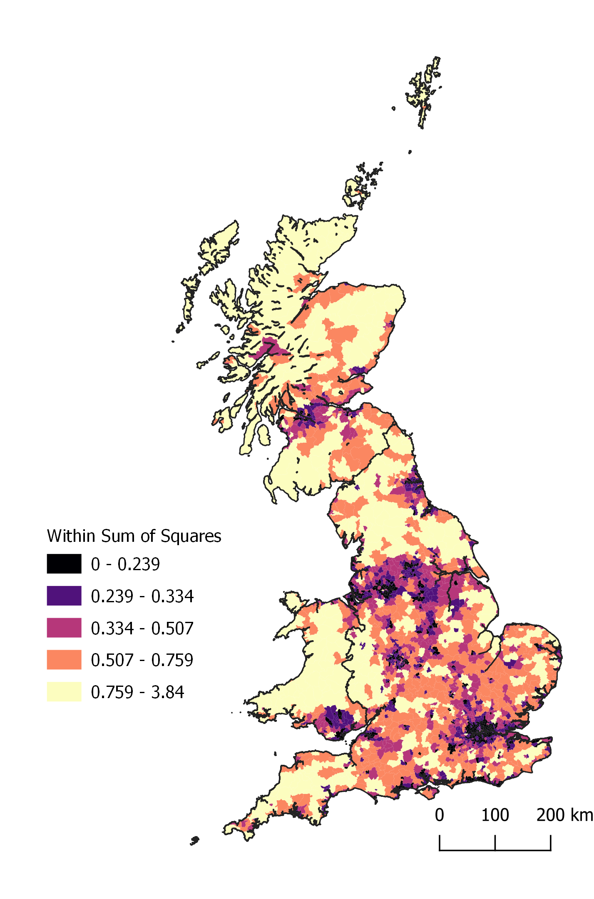
Internal Validation
Greater error in more rural areas
CAE is learning structure from a larger amount of data derived within urban locations (more postcodes)
Spatial smoothing has more effect in urban areas

Slide 42
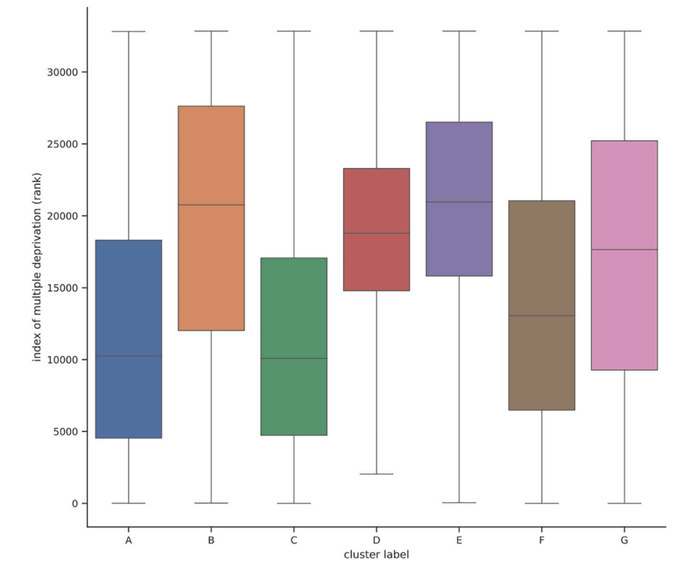
External Validation
Comparison with Index of Multiple Deprivation (IMD)

Slide 43
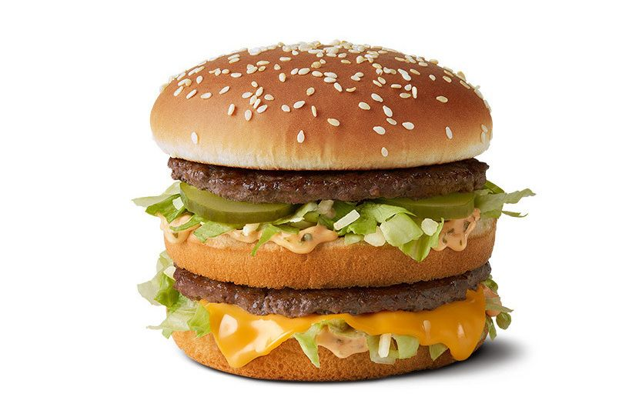
Takeaways
Very effective new technique
Even with input data at the resolution of Sentinel 2 (10 m / pixel), the autoencoder process through CNN was illustrated to be extremely sensitive
Requiring spatial smoothing of the raw outputs to limit unhelpful heterogeneity.
Interesting relationship between zone size (enabled by data) and the output model – MAUP
How would model performance be effected by more limited geographic extent

Slide 44
Video Analytics and Health
A deep learning approach to identify unhealthy advertisements in street view images
The challenge: Measuring differences in exposure to advertising
Using deep learning to identify unhealthy ads in street view images
Examining inequalities in advertisement locations

Slide 45
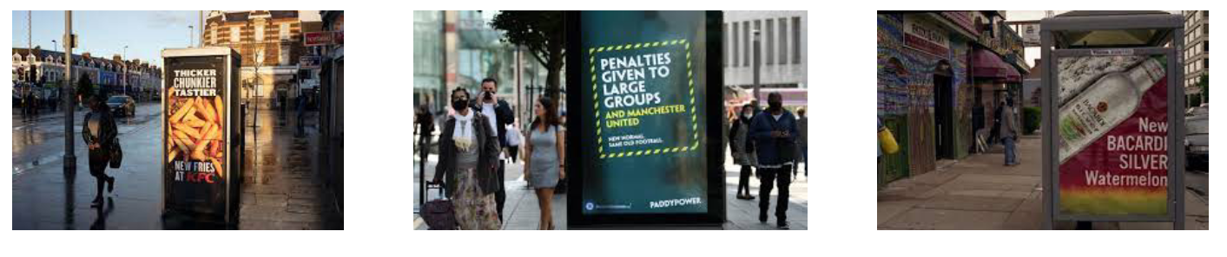
The Challenge
There is a growing concern among public health officials regarding the number of advertisements for risky products e.g., alcohol, gambling, unhealthy food and beverages.
When advertisements are prevalent within deprived areas, or areas with high levels of obesity, their role may counter public health efforts to tackle health inequalities.
Evidence suggests a socio-economic difference in exposure to outdoor food advertising, where larger spaces were found to be devoted to food advertisements within less affluent areas.

Slide 46
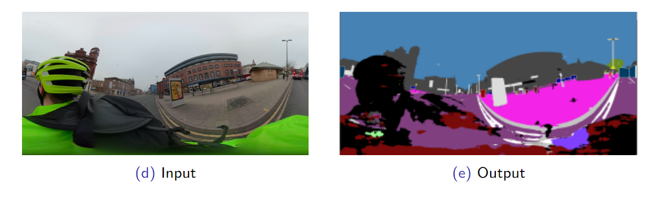
A Deep Learning Approach
There are limited to no data, therefore we don’t really know the scale of the issue
Understanding who is exposed and evaluating potential policy interventions requires substantial manual data collection
Deep learning workflow to automatically extract and classify unhealthy advertisements from street-level images.

Slide 47
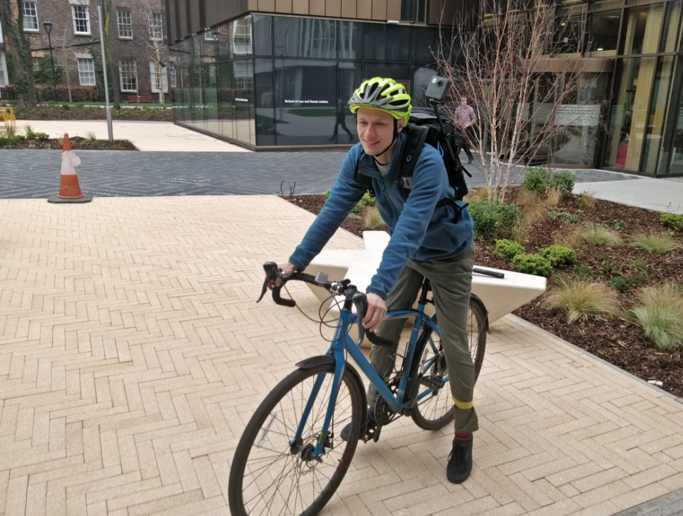
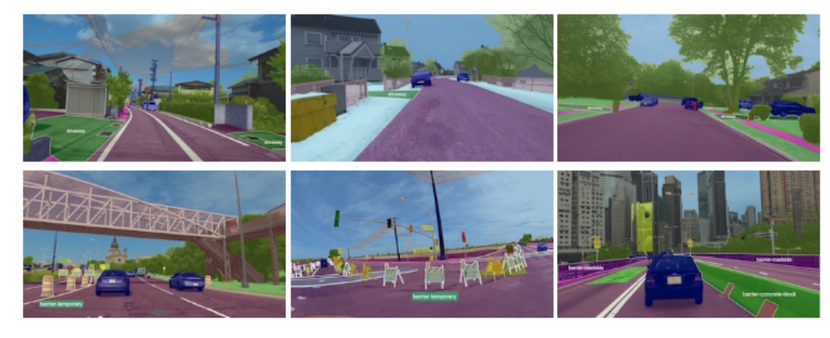
Data
Mapillary Vistas Dataset.
The Liverpool 360°Street View (LIV360SV) Dataset.
Sample annotations of the object classes within the Mapillary Vistas Dataset(https://www.mapillary.com/dataset/vistas).

Slide 48
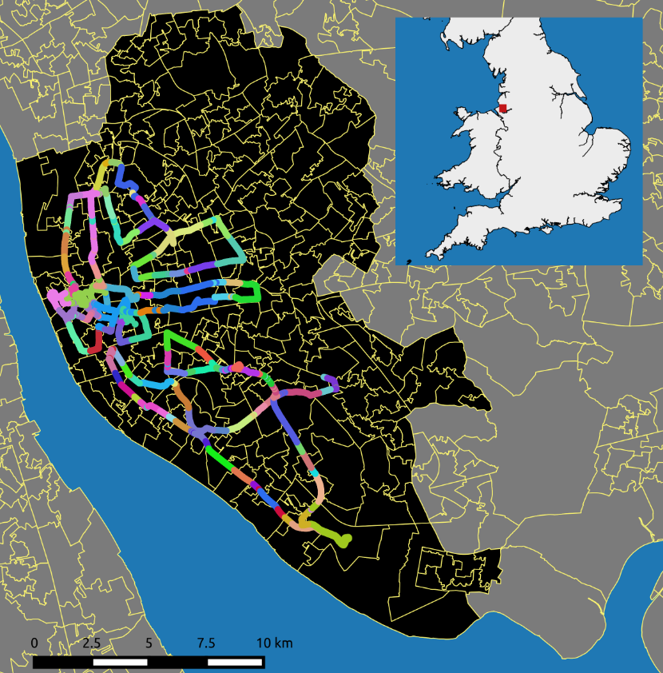
The Liverpool 360 Street View Dataset
The camera records front and back images at 0.5 second interval.
The images are stitched together using GoPro Fusion Studio.
To date our dataset consists of 25,349 street-level images each with GPS location recorded.

Slide 49
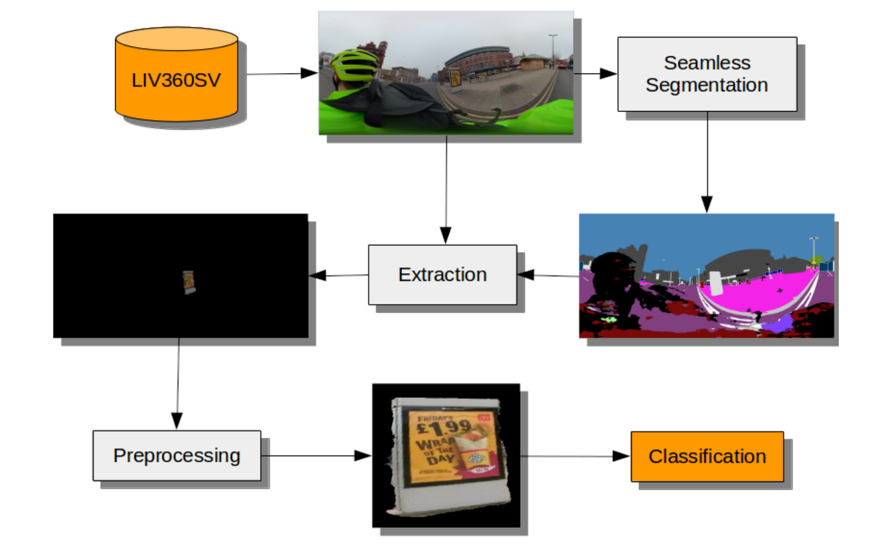
Advertisement Classification Workflow
Upon removing near duplicate advertisements we are left with food (873),alcohol (102), gambling (79) and other (6247) advertisements.

Slide 50
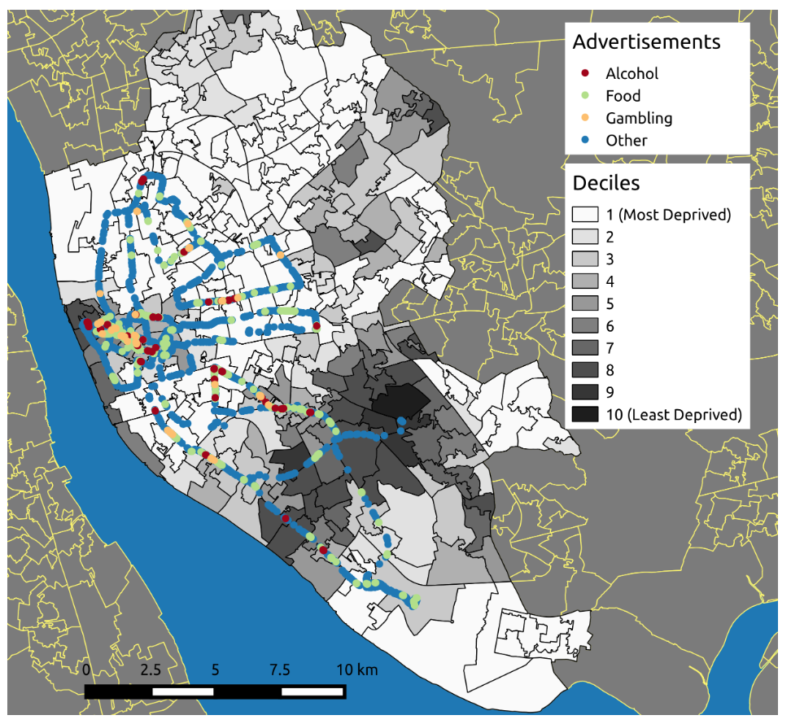
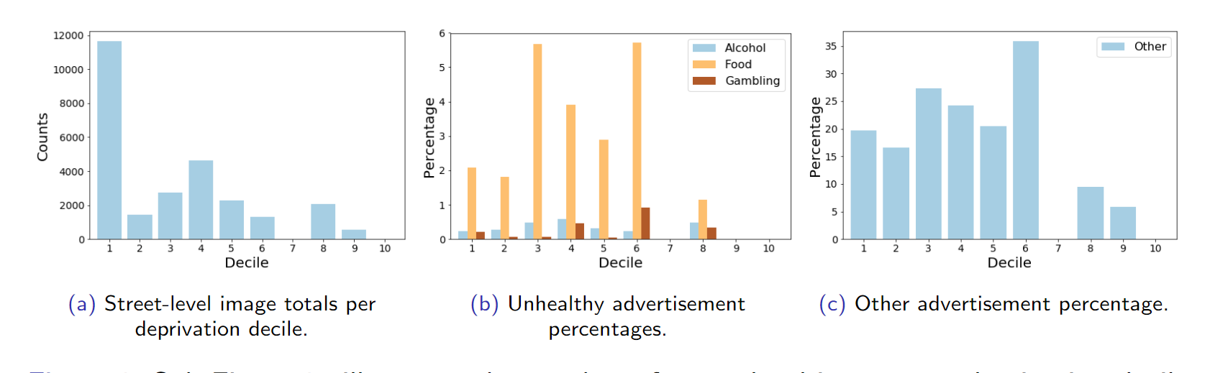
Deprivation and Advertisement Locations
Larger proportion of food advertisements located within deprived areas and those frequented by students.

Slide 51
Takeaways
Can combine GDS with innovative data feeds to provide new insight into cities
Create platforms for analysis with wide applications

Slide 52
Conclusions
Geographic Data Science provides utility to derive new insights about urban environments
Can utilise new or re-purposed data sources
Requires interdisciplinary working

